Slide 1
Contingency Management in Wetlands
Paul R. Krause, Ph.D.
Knowledge Management Program
Sensitive Ecosystem Workshop Bogota, Colombia November 2012

Slide 2
Contingencies for Impacts
The largest impacts related to E&P activities in wetlands are spills and erosion
Spills from operations, pipelines, transportation activities all can introduce contaminants into the wetland at different levels
Infrastructure development and operations can enhance erosion throughout the wetland
Spill Response - Basics
Erosion Control - Tools

Slide 3
Oil Spill Response
The world’s leading sustainability consultancy

Slide 4
Spill Response Basics
Typical Spill and Response Timeline
Final Phase – Restoration
ICS is disbanded
Responsible Party takes responsibility for remediation/mitigation
Second Phase – Containment
SCAT and Containment teams operate through ICS
Third Phase – Cleanup
SCAT and cleanup teams operate for closure of the spill
Incident Occurs
Someone Notices
Initial Response – Stop the Leak
Agencies and Unified Command formed under Incident Command System Shoreline Cleanup and Assessment Teams mobilized

Slide 5
Spill Response - Command Structure
Incident Command System (ICS)
Command Structure of Agencies
Coordinates the function of response Agencies
Federal
State
Local
Responsible Party (RP)
ICS was formed from the response to wildfires
First implemented in 1989 San Francisco earthquake
September 11 attack
Hurricanes Rita, Katrina, Sandy
Other natural or public disasters
Deepwater Horizon
United States Coast Guard is lead Federal Commander
Unified Command = Federal, State, and RP leads

Slide 6
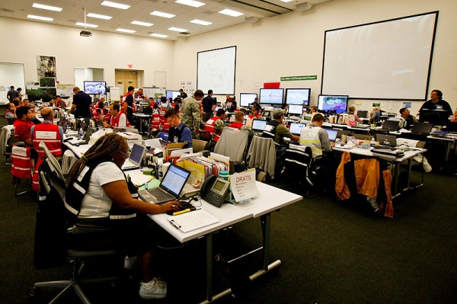
Deepwater Horizon ICS

Slide 7
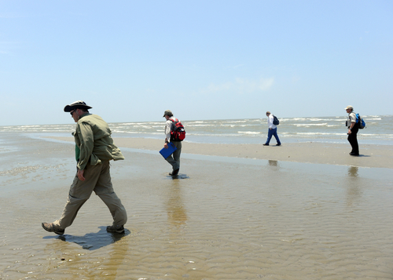
Spill Response - SCAT
Shoreline Clean up and Assessment Team (SCAT)
Function to collect real-time data and provide feedback to the ICS
Shoreline type – Beach, wetland, rocky shore, coral reef
Accessibility – Can the oil be accessed by clean up crews?
Oiling conditions – How much oil, type of oil?
Logistics – How does the clean up crew access the area? When?
Need for cleanup – Does this area need clean up?
Collect chemical data
Hydrocarbon fingerprint data
Water
Sediment
Identify clean up strategy
Identify resources at risk
Habitat
Population

Slide 8
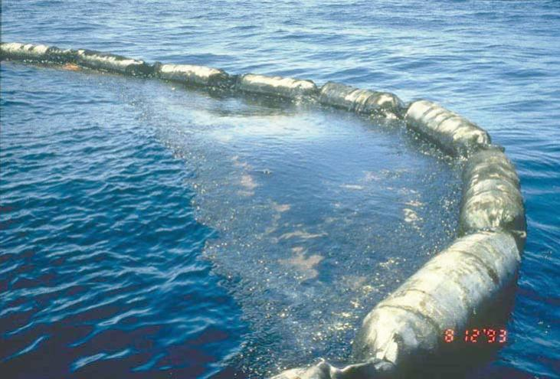
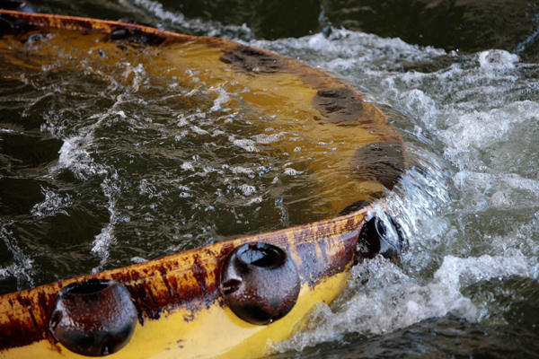
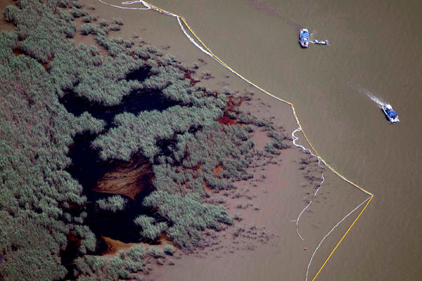
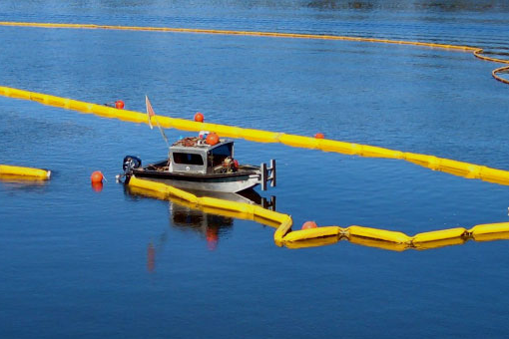
Spill Response - Containment
Oil Containment Technology - Booming

Slide 9
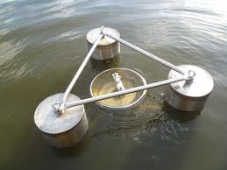
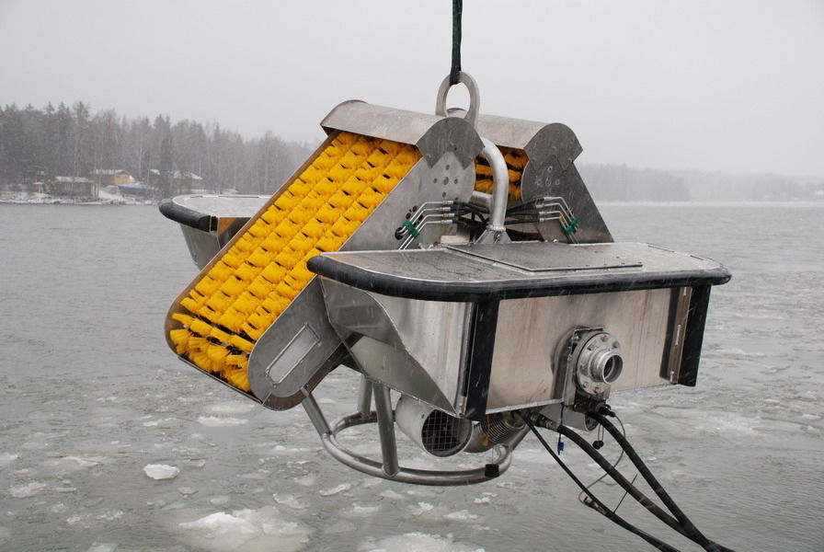
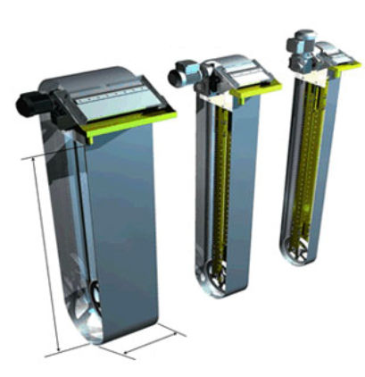
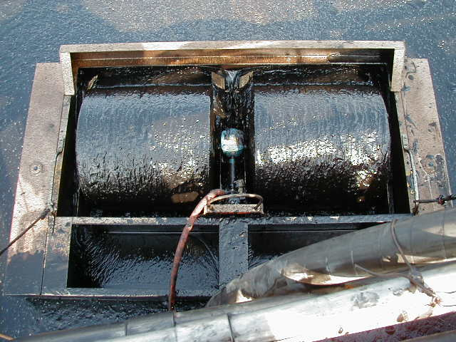
Spill Response - Collection
Oil Collection Technology - Skimming

Slide 10
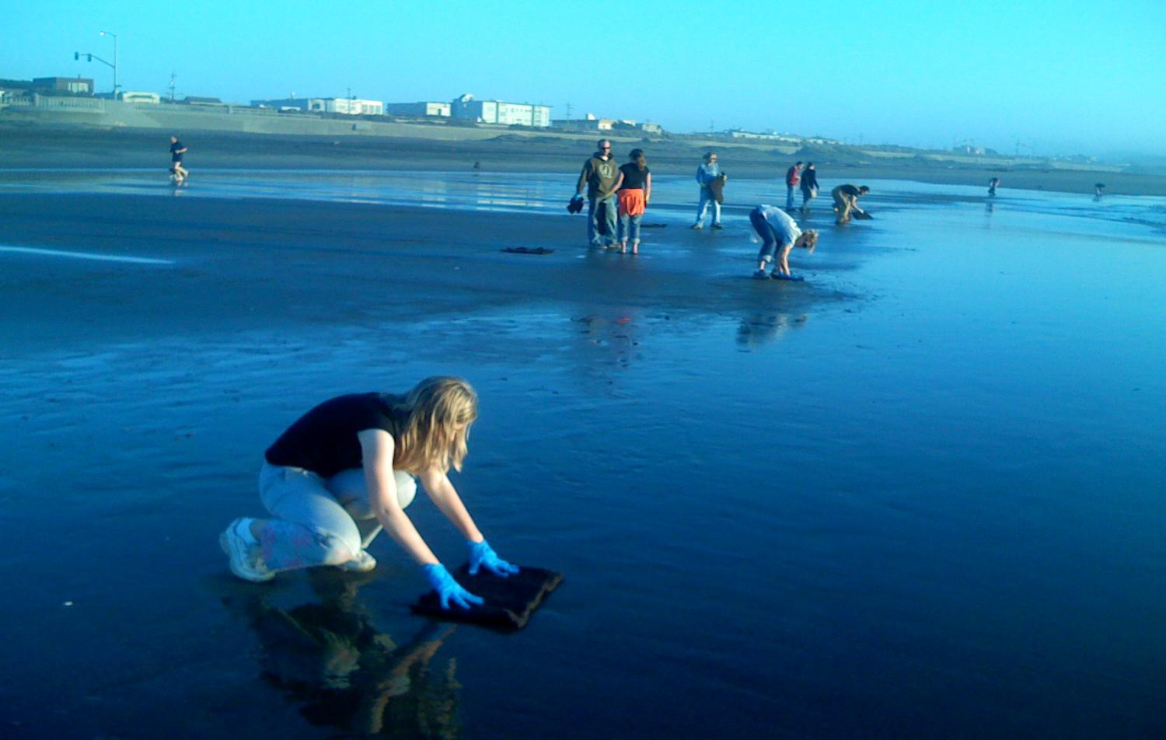
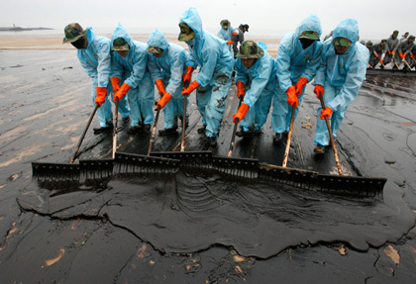
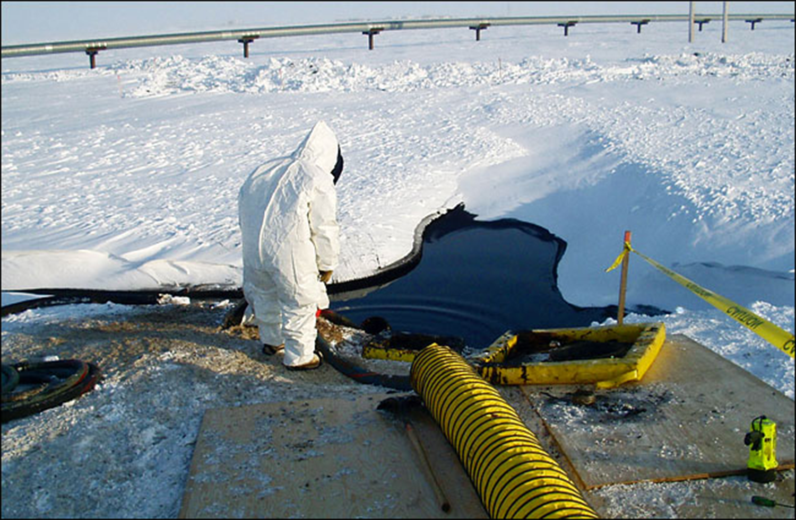
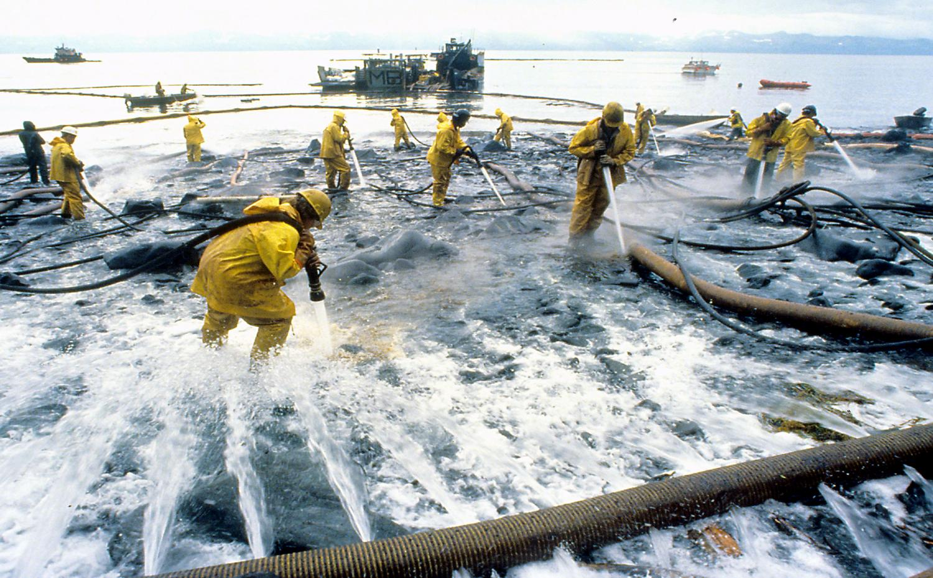
Spill Response – Other Methods
Absorbent Pads
Manual Herding
Oil Vacuum Suction
Pressure Washing

Slide 11
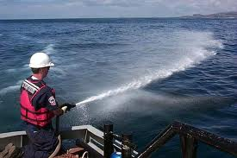
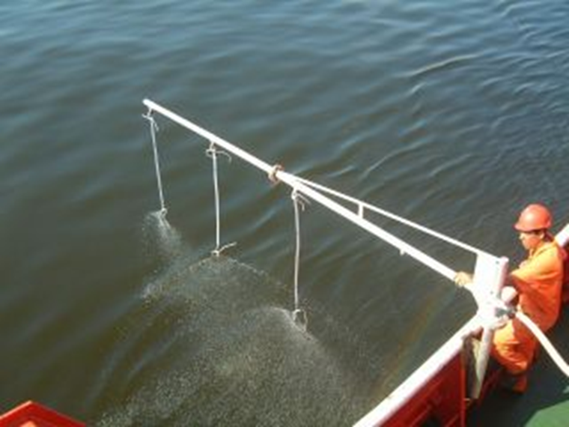
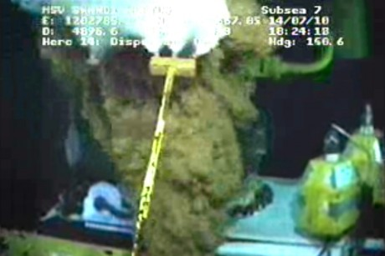
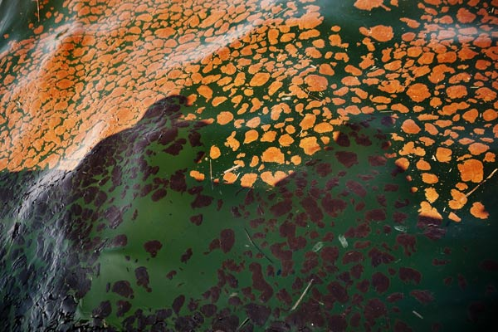
Spill Response - Dispersants
Oil Collection Technology - Dispersants

Slide 12
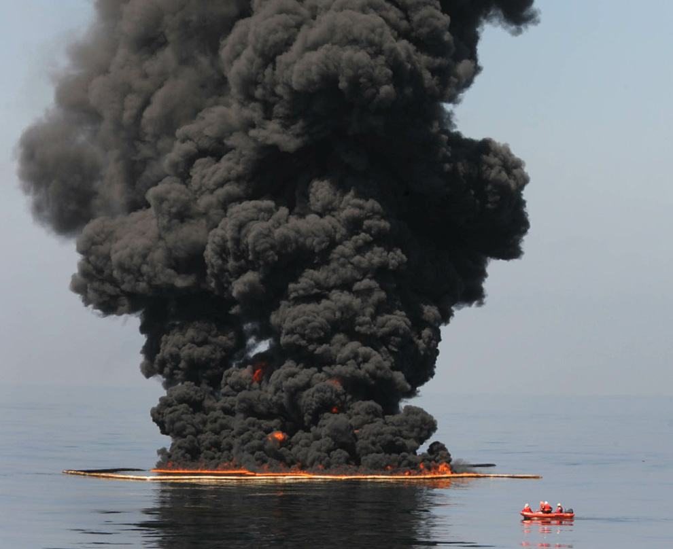
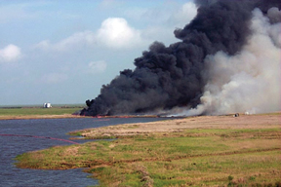
Spill Response – In-Situ Burning
Burning is most effective way to remove hydrocarbons
Can be done at sea or on land
Requires specialized fire-resistant boom at sea
Multiple hazards associated with burning
Loss of control
Air quality issues
Habitat destruction

Slide 13
Erosion Control
The world’s leading sustainability consultancy

Slide 14
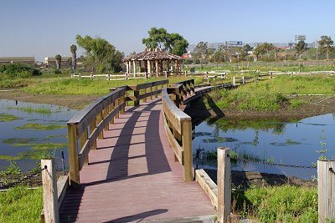
Erosion Control - Wetland
Erosion can be stopped or contained before it creates a problem.
Sediment transport should be monitored regularly
Utilize Best Management Practices for erosion control
Regulate traffic to reduce soil destruction
Foot Traffic
Vehicle Traffic

Slide 15
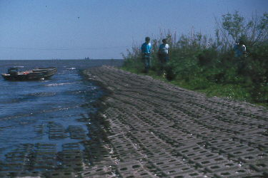
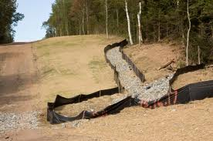
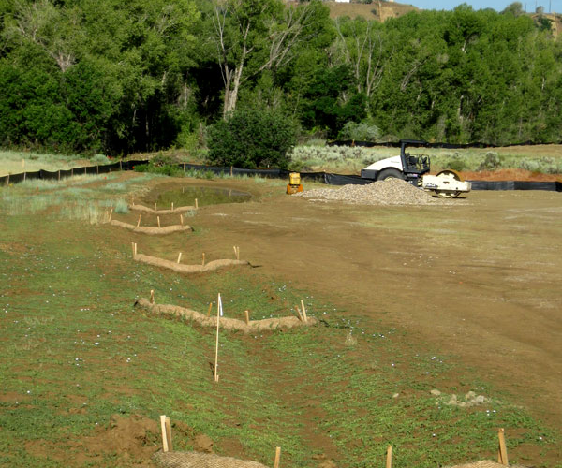
Erosion Control - Wetland
Erosion can be stopped or contained before it creates a problem.
Shoreline protection
Armoured Mats
Construction Protection
Protective waddles
Silt fences

Slide 16
Conclusions
Oil spills and Erosion are major impacts on wetland habitats
Oil spill protection requires a robust spill response strategy
Incident Command System
SCAT Teams
Data collection
There are many technologies available to fight spills
Erosion can be controlled before and during project activities

Slide 17
Effects on Wetland Function or Service
Any Questions?

Slide 18
www.erm.com

