Slide 1
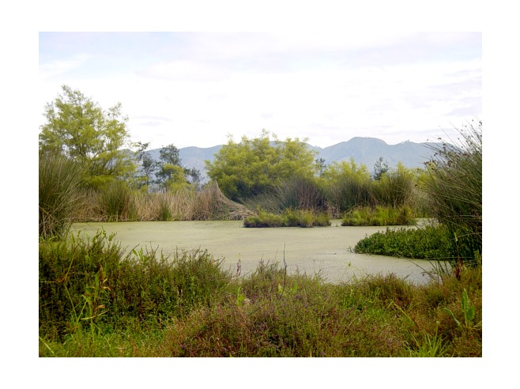
Legislation and Regulation of Wetlands
The world’s leading sustainability consultancy

Slide 2
Legislation and Regulation of Wetlands - US
US Federal Legislation Protecting Wetlands
Clean Water Act
Rivers and Harbors Act
Coastal Zone Management Act
Coastal Barriers Resources Act
US Wetland Regulatory Programs Oversight Authority
US Army Corps of Engineers (USACE)
US Environmental Protection Agency (USEPA)
US National Marine Fisheries Service (USNMFS)

Slide 3
Legislation and Regulation of Wetlands - US
The primary mechanism for wetland protection in the US falls under Section 404 of the Clean Water Act (CWA) and Section 10 of the Rivers and Harbors Act (RHA)
Section 404 of the CWA requires authorization from the USACE for the placement of dredged or fill materials into wetlands and other US waters.
This section helps protect wetlands from being damaged or filled without review.
Illegal dumping in wetland – violation of Section 404 of CWA

Slide 4
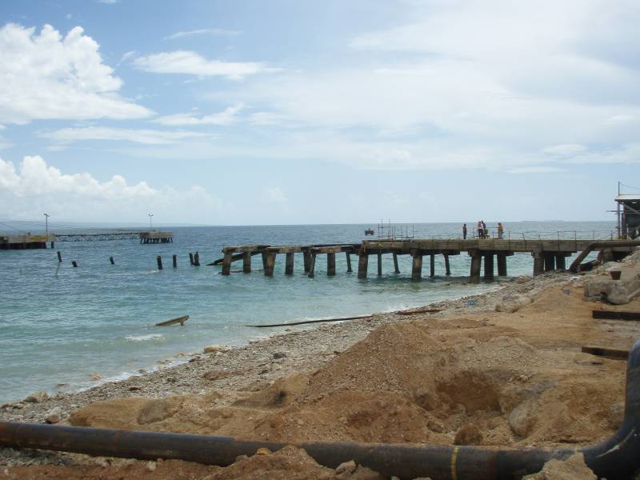
Legislation and Regulation of Wetlands - US
Section 10 of the RHA regulates operations around “navigable waters”
Authorized by the USACE
Construction in or over waterways
Excavation and dredging
Disposal of material
Alteration of water course
Obstruction of waters "Navigable waters" are those subject to the ebb and flow of the tide shoreward to the mean high water mark. The term includes coastal and inland waters, lakes, rivers and streams that are navigable and the territorial seas.
Sections 10 and 404 overlap in some activities involving wetlands. Permits for activities regulated under both are processed simultaneously by the USACE.

Slide 5
Legislation and Regulation of Wetlands - US
The Coastal Zone Management Act (1972) and the Coastal Barriers Resources Act (1982) by setting policy – NOT regulating activity.
The Coastal Zone Management Act encourages states to establish voluntary coastal zone management plans and provides funds for developing and implementing the plans.
The Coastal Barriers Resources Act denies Federal subsidies for development within undeveloped, unprotected coastal barrier areas, including wetlands, designated as part of the US Coastal Barrier Resources System.
Transfers financial responsibility to the developer and not the US Government

Slide 6
Recent Updates in US Wetland Regulations
In 2006, the US Supreme Court reviewed the scope of Section 404 of the CWA.
The decision provides new standards for determining whether wetlands are subject to CWA jurisdiction and set up the wetland delineation program.
Eliminated federal protection of many inland “hydrologically isolated” wetlands.
Hydrologically isolated “prairie pothole” wetland, Nebraska USA
2006- US Supreme Court Rapanos v. US and Carabell v. US.

Slide 7
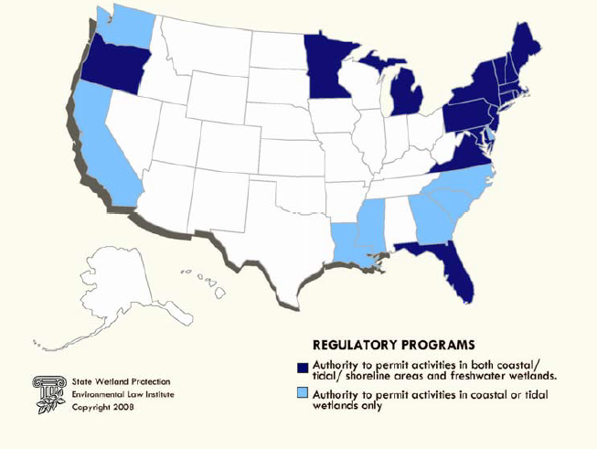
Legislation and Regulation of Wetlands - US
US States also have the authority to enact their own regulatory programs for wetlands.
State programs can be more stringent than the federal program.
New York, Washington, and California are among the states with strong wetland regulations.

Slide 8
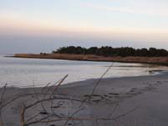
Legislation and Regulation of Wetlands - US
States often use a combination of approaches in an effort to provide more comprehensive protection of wetlands.
In addition to Federal CWA requirements, North Carolina has adopted rules pertaining to wetlands that fall outside federal jurisdiction, requiring water quality permits for “isolated” wetlands. The state has also enacted a separate regulatory program for coastal wetlands.
Both Michigan and New Jersey have assumed the Federal CWA program, but have also adopted coastal-specific regulatory requirements that are more stringent than the federal regulations.
New Jersey Coastline

Slide 9
Authorizing Activities within Wetlands
Federal and state permits are required for projects that have unavoidable impacts to wetlands
Federal permitting process can take between 6 months to 3 years, depending on the complexity of the project and agency backlog.
Proposals involving major impacts to federally-protected wetlands also trigger other federal environmental regulations, such as the National Environmental Policy Act
State permitting can have a similar processing time as the federal process but are typically accomplished simultaneously with the federal process.
Authorized impacts to wetlands under federal or state regulations require mitigation.

Slide 10
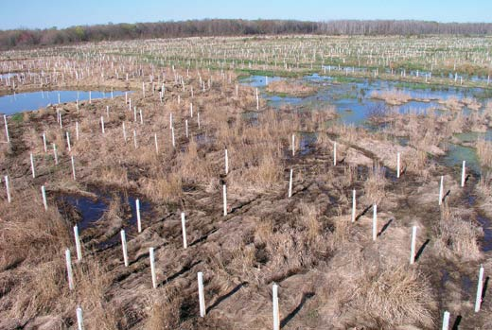
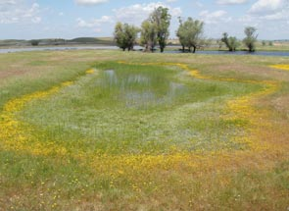
Mitigation for Wetland Impacts – New US Approach
In 2011, USACE officially declared their support for wetland banking as the primary means for wetland mitigation.
When a land developer impacts a wetland they may buy offsets from an approved mitigation banker. The mitigation banker restores, enhances, creates or preserves an area of wetland to generate credits.
The number of credits available at a mitigation bank is related to the area of wetland and/or the functional value of the wetland.
Images of two wetland mitigation banks in California and Virginia, USA.

Slide 11
Mitigation Banking – The Way Forward
Mitigation banks are essentially large mitigation sites for multiple projects
Mitigation bank credit prices range anywhere from $3,000 to $600,000 USD per credit.
The variability in the market value of credits reflects differences in the availability and price of land suitable for bank development and the cost to create an acre of wetland compensation within a given region.
Snohomish County, Washington Mitigation Bank designed to mitigation for impacts to wetlands and rare species

Slide 12
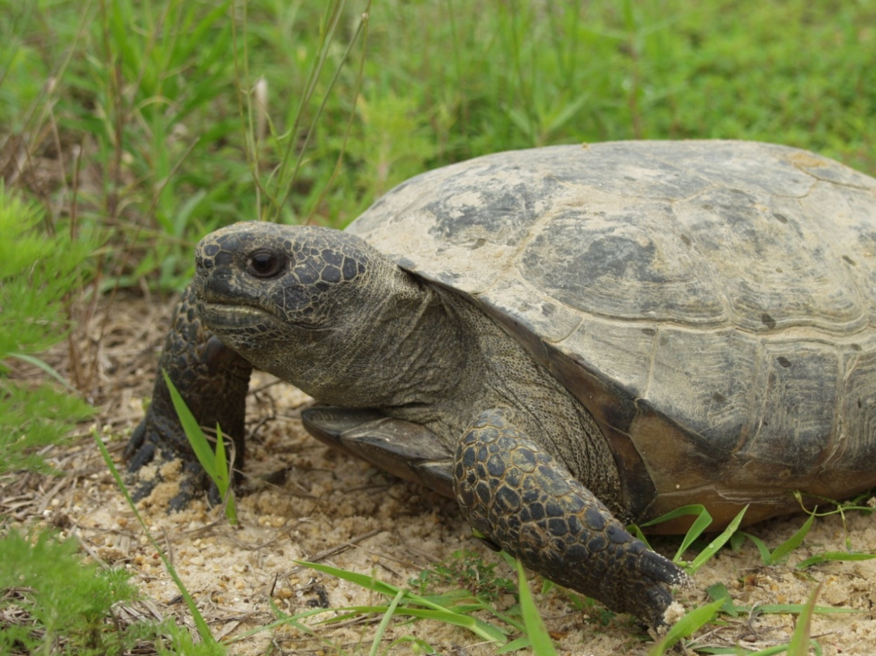
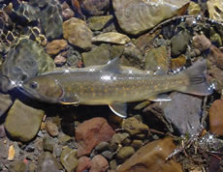
Mitigation Banking – The Way Forward
Wetland mitigation banking is now expanding into biodiversity banking where credits for impacts to other regulated resources (endangered species, water quality) can be purchased.
Currently, there are over 120 approved biodiversity banks in the US covering over 400 ha and protecting over 60 listed species.

Slide 13
Conclusions
US Federal regulations provide the overall framework for wetlands regulations.
Clean Water Act
Rivers and Harbors Act
US Federal policy provides the financial framework for development in wetlands
Coastal Zone Management Act
Coastal Barriers Resources Act
US States have the ability to regulate wetland operations and developments if they choose to
Oil and gas exploration projects are subject of all wetland regulations
Oil and gas projects must satisfy the regulatory process through impact analysis and planning in consultation with the regulatory agencies.

Slide 14
Effects on Wetland Function or Service
Any Questions?

Slide 15
www.erm.com

