Slide 1
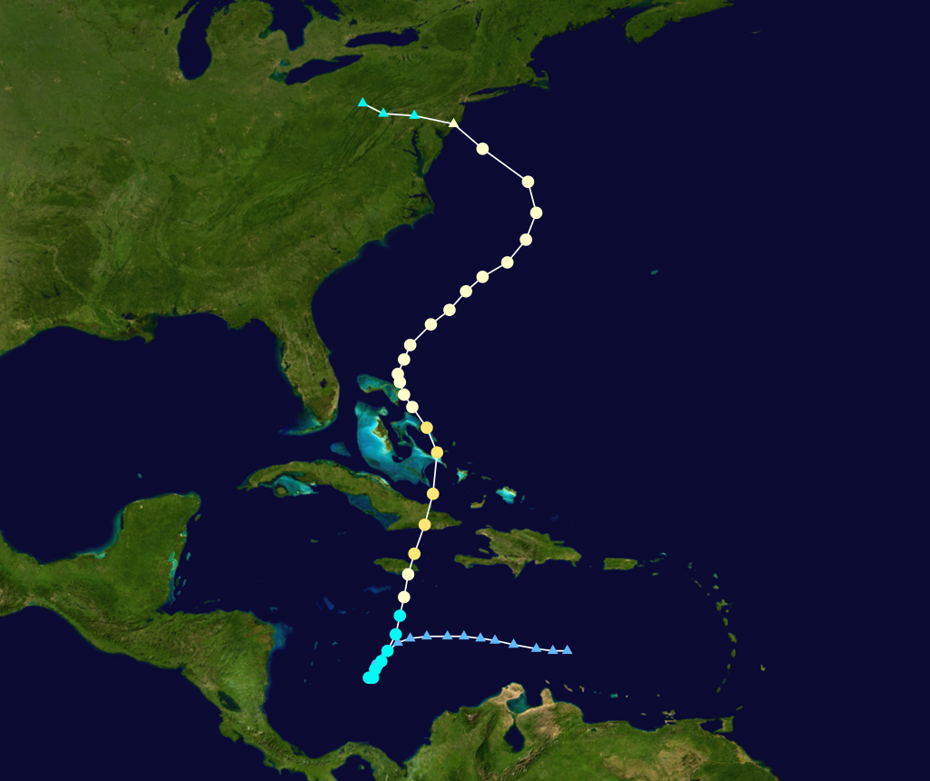
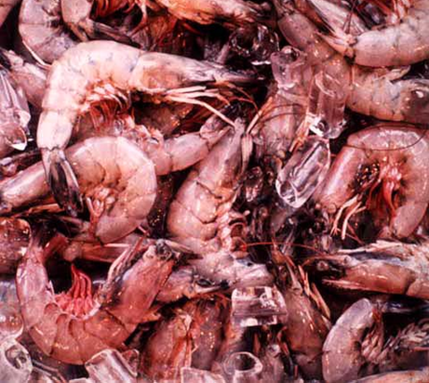
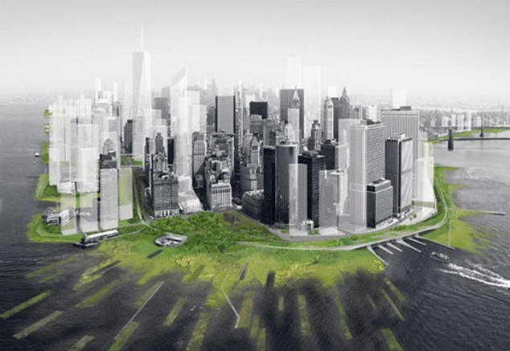
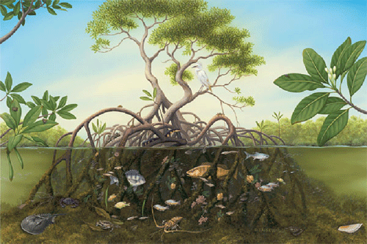
Socio-economic Importance of Wetlands
Source: http://www.naturefoundationsxm.org/education/mangroves/red_mangrove.htm
The world’s leading sustainability consultancy

Slide 2
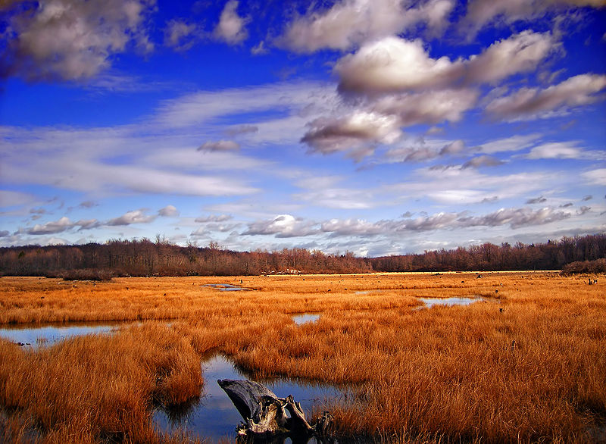
Socio-economic Importance of Wetlands
Global benefits provided by wetlands are valued at $14.9 Trillion per year (US GDP for 2011 was $15.09).
75% of commercially harvested fish are wetland-dependent. Add shellfish species and that number jumps to 95%.
The ability of wetlands to control erosion is so valuable that every coastal state in the US now has developed wetland restoration programs

Slide 3
Socio-economic Importance of Wetlands
Wetlands play an important role in both ecosystem health and also social and economical aspects of our lives.
In the past few years the importance of wetlands in the United States has been prominent due to extraordinary events:
Hurricanes
Sandy
Katrina
Rita
Source: http://www.naturefoundationsxm.org/education/mangroves/red_mangrove.htm

Slide 4
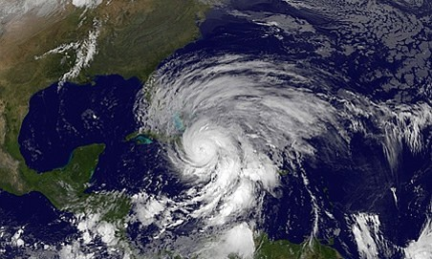
Socio-economic Importance of Wetlands
Hurricane Sandy
Largest Atlantic storm:1,700 km wide.
209 fatalities in seven countries.
Economic losses estimated at $52.4 Billion. Second most expensive in U.S. history.
In NY there was wide spread flooding including subway stations and tunnels.
May not be able to rebuild on flooded land.
Notes:
“Role in…”
http://liveassets.iucn.getunik.net/downloads/03e_economic_valuation_of_wetlands.pdf
http://www.epa.gov/gmpo/about/facts.html

Slide 5
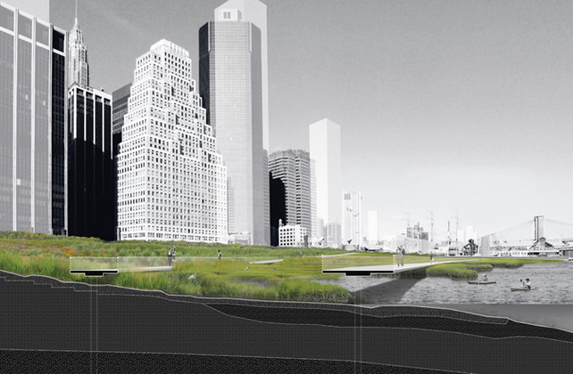
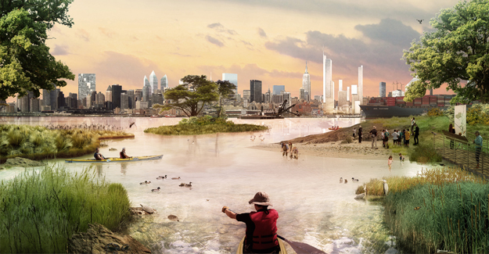
Socio-economic Importance of Wetlands
Hurricane Sandy
Restoration and creation of new wetlands is being discussed
dissipate storm surge, flooding
Proposals now being considered to greatly expand wetlands in the New York estuary and Hudson River
Protection for economic disasters in the future.
Architecture Research Office
“Dredgescape” - W Architecture & Landscape Architecture, LLC
Notes:
Dredgescape” proposal to use the entire estuary as a park and creating a series of launches and landings for human powered water vessels. The islands are grouped across from one another on the shores of New Jersey and New York, making it possible to kayak from one side to the other more easily. The archipelagos will be place at intervals approximately two rowing hours apart from the port at the base of Manhattan all the way up the estuary to Troy New York. This will allow for trips at all skill levels and even offer camping amenities for a weeklong trip. While greatly expanding the recreational experiences for the community, the islands would also create a rich ecology making a more sustainable and stable environment. “Dredgescape” would greatly increase the wetlands in the Hudson River, providing a more natural and diverse ecosystem
Reference:
Dredgescape - http://www.w-architecture.com/?sec=projects&pg=glimpses
NYC Wetlands side view - http://www.fastcodesign.com/1664977/how-design-can-save-nyc-when-the-next-big-storm-hits

Slide 6
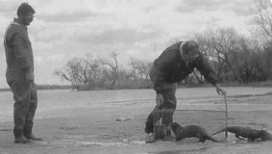
Socio-economic Importance of Wetlands
Coastal Wetlands of Louisiana
Economic benefit of nearly $1000 per hectare.
Fisheries
Animal trapping
Recreation
Storm protection
Commercial fishing and trapping account for 19% of the total, recreation for 2% and storm protection services make up the remainder.

Slide 7
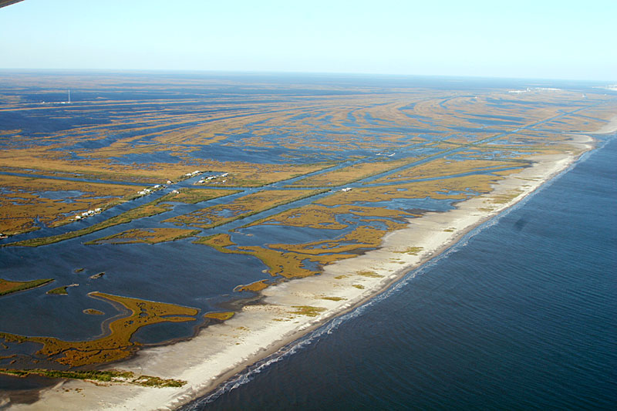
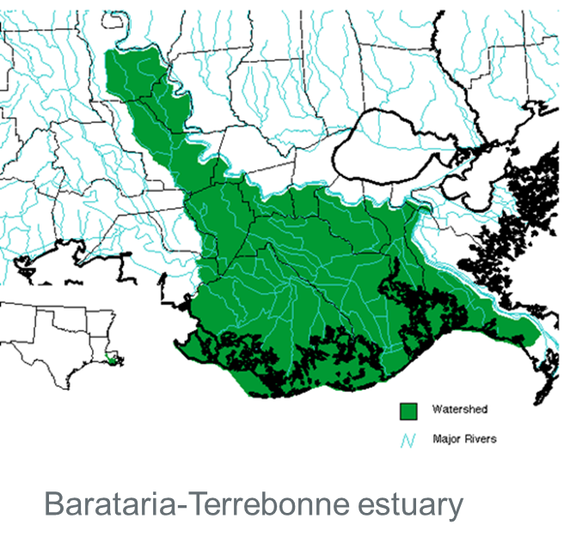
Socio-economic Importance of Wetlands
Coastal Wetlands of Louisiana
Essential habitat for fish and migratory animals.
Migratory waterfowl - about 75% of all birds traversing the U.S.).
seabirds, wading birds, furbearers, and sport and commercial fish.

Slide 8
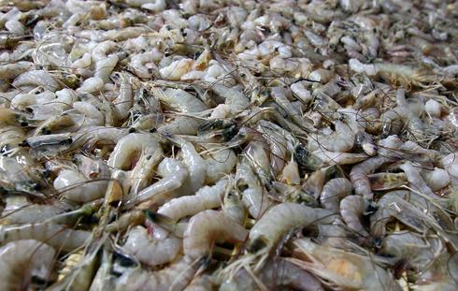
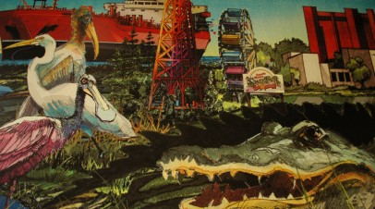
Socio-economic Importance of Wetlands
Coastal Wetlands of Louisiana
Benefits from fish and wildlife habitats
Commercial Fishing - $202 million, accounting for approximately 21% of the total catch in the US
Recreational Fishing –$895 million and $1.2 billion/yr.
Hunting – $500-600 million/yr.
Wildlife-watching – $175 million/yr.
Fur Harvest - $1.17 million/yr.
Alligator Harvest - $35-50 million/yr.

Slide 9
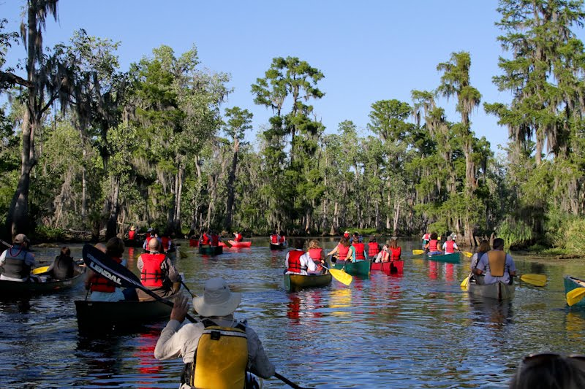
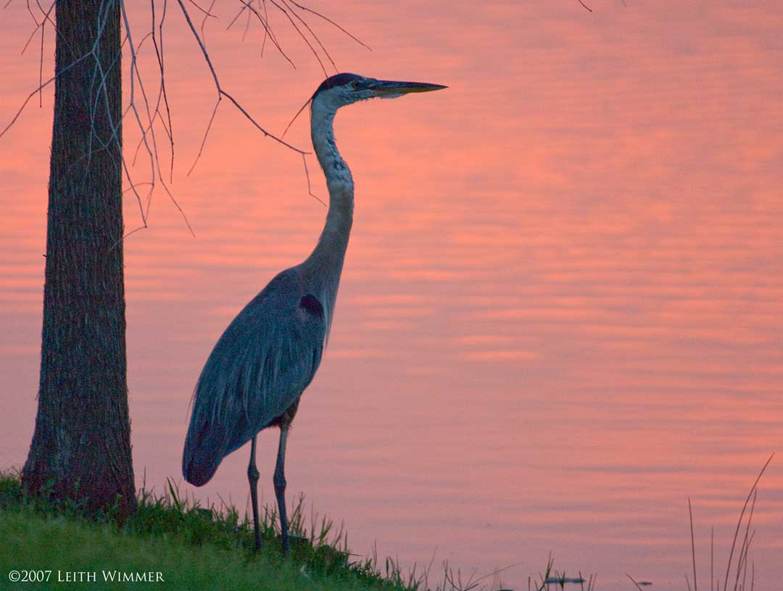
Socio-economic Importance of Wetlands
Coastal Wetlands of Louisiana
Benefits from recreation
The Gulf supports a $20 billion tourist industry, a large part due to its beaches and recreational fishing opportunities both of which depend on healthy wetlands

Slide 10
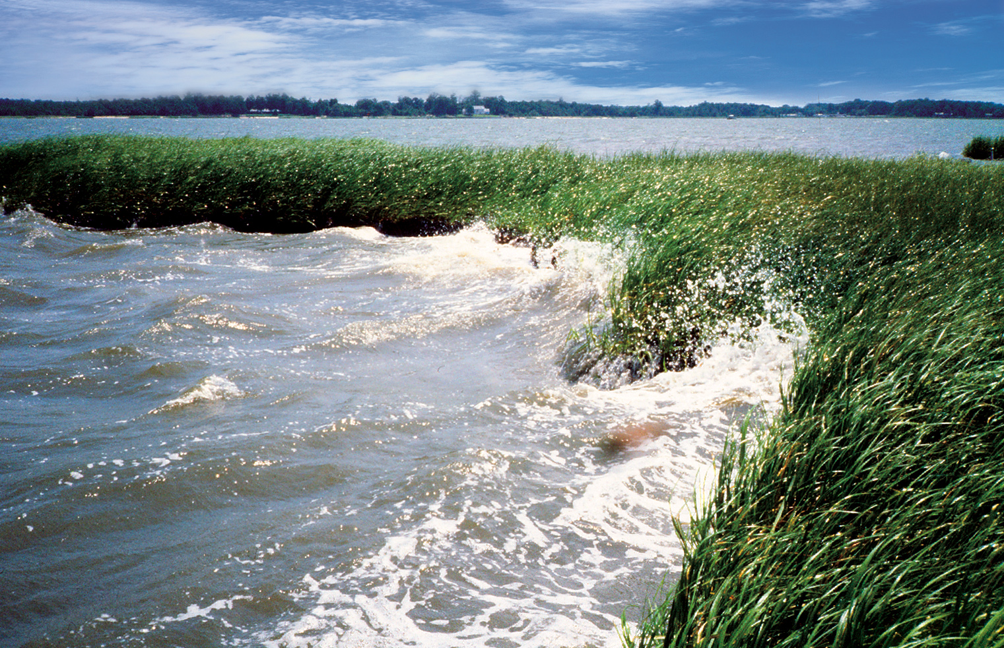
Socio-economic Importance of Wetlands
Coastal Wetlands of Louisiana
Benefits from shoreline erosion protection
Louisiana is losing 6.500 – 9,000 ha of wetlands per year to sea level rise and storms
Hurricanes Katrina and Rita transformed 56,000 ha of marsh to open water in coastal Louisiana
The loss 1.6 km of wetlands results in an estimated $5.7 Million average annual increase in property damage due to erosion.
Source: www.noaa.gov

Slide 11
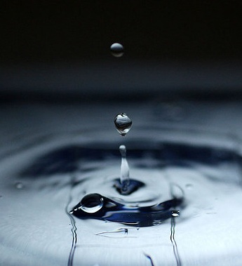
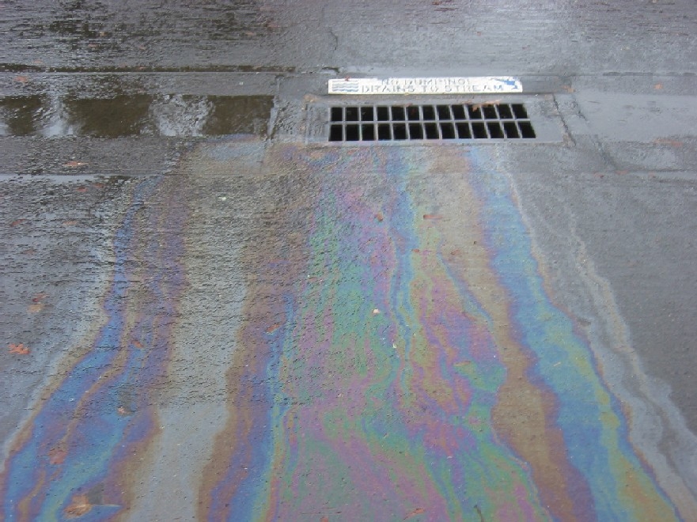
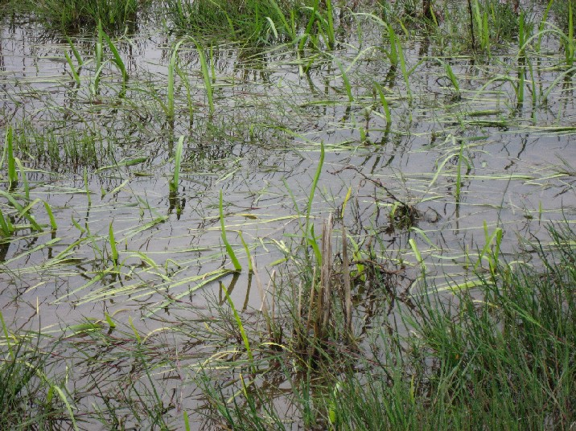
Socio-economic Importance of Wetlands
Coastal Wetlands of Louisiana
Benefits from natural water quality improvement
Filter buffer for contaminants - The Mississippi River contributes more than 90% of the fresh water entering the Gulf (12.5 million liters per second).
Improve water quality
Can equal the capacity of a $5 million treatment facility.
Source: http://www.lanecounty.org/Departments/PW/WMD/EnvironServices/Pages/Wetlands-GeneralInformation.aspx

Slide 12
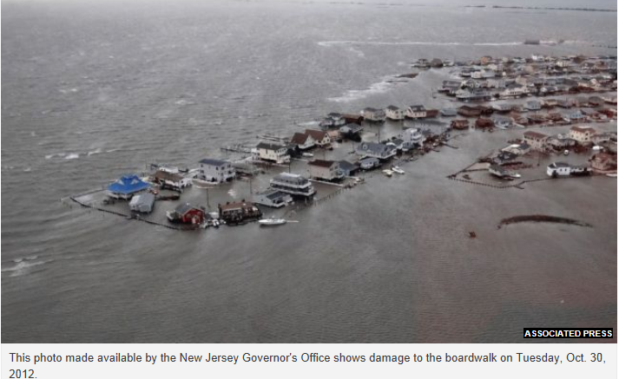
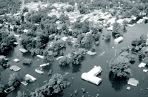
Socio-economic Importance of Wetlands
Coastal Wetlands of Louisiana
Benefits from flood storage
1 ha of wetland can store 14.2 million liters of floodwater.
The Great Flood of 1993 in the upper Mississippi River Basin
Billions of dollars in property damage
38 deaths
8 million ha of wetlands in this area had been drained or filled before the flood.
Notes:
U.S. Army Corps of Engineers found that protecting wetlands along the Charles River in Boston, Massachusetts, saved $17 million in potential flood damage.

Slide 13
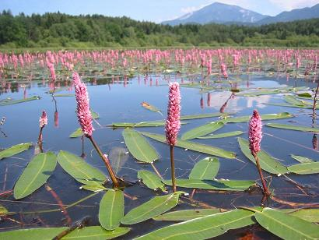
Socio-economic Importance of Wetlands
More resources:
The Economic Values of the World’s Wetlands
http://assets.panda.org/downloads/wetlandsbrochurefinal.pdf
The Economic Value of Wetland Conservation and Creation: A Meta-Analysis
http://ideas.repec.org/p/fem/femwpa/2008.79.html
Thank you!

