Slide 1
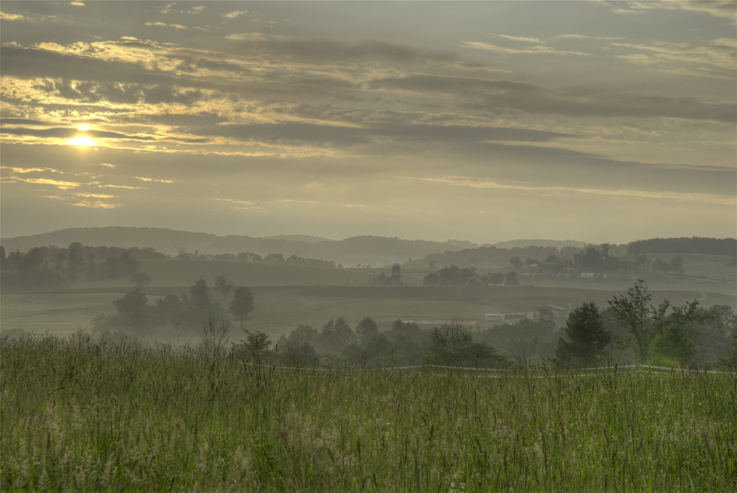
Natural Gas Development from Shale Opportunities and Challenges for Communities.
Jon Laughner, EcoPetrol, December 5, 2012
JBLaughner@psu.edu; 724-333-5765

Slide 2
Social Challenges
Community Impacts
Socialization Procedures
Case Studies

Slide 3
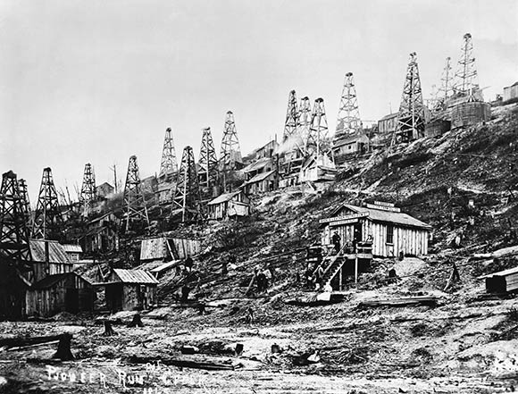
August 27, 1859
Titusville, Pennsylvania
Notes:
1859: Drillers strike oil near Titusville, Pennsylvania. It becomes the first commercially viable oil well in the United States, the prototype for future oil well construction, and marks the birth of the U.S. petroleum industry.
That the land around Crawford County held plenty of oil was already well-known. What was lacking was an effective method for extracting the crude and getting it to market. Enter Edwin Drake, who had spent the previous decade locating oil deposits in the area for the Seneca Oil Company.

Slide 4
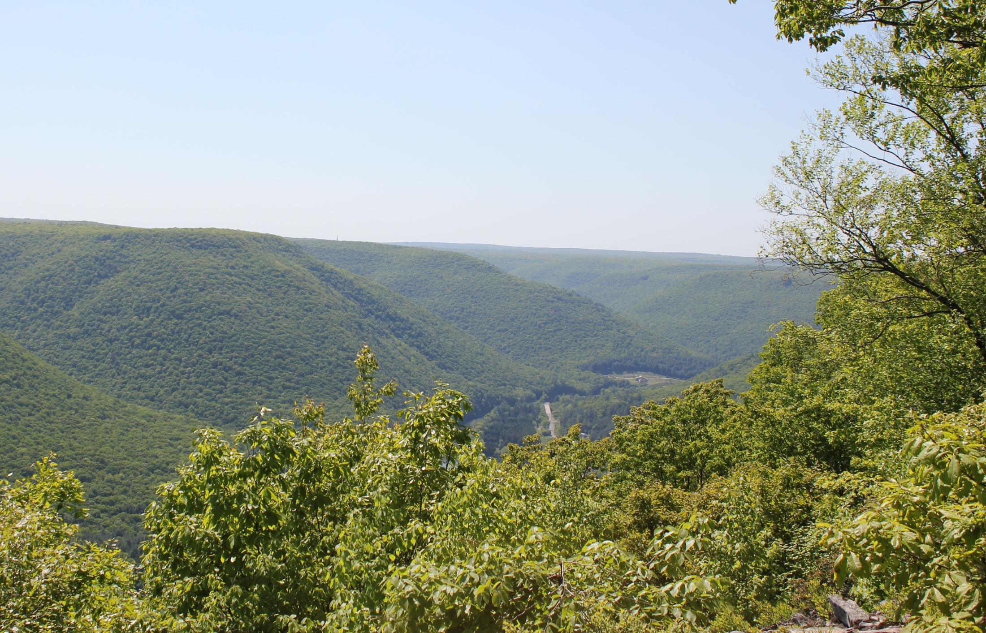
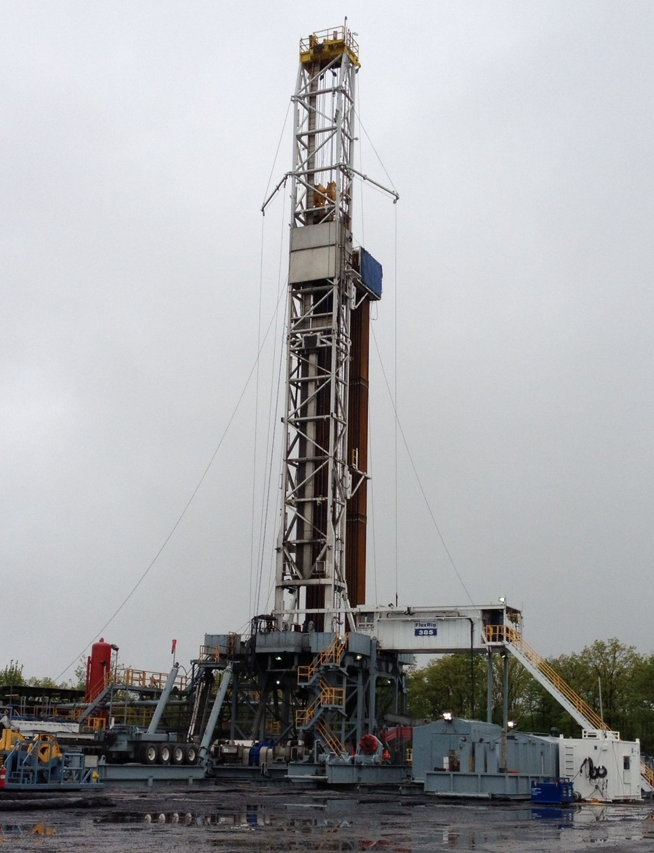
Find the Drilling Rig

Slide 5
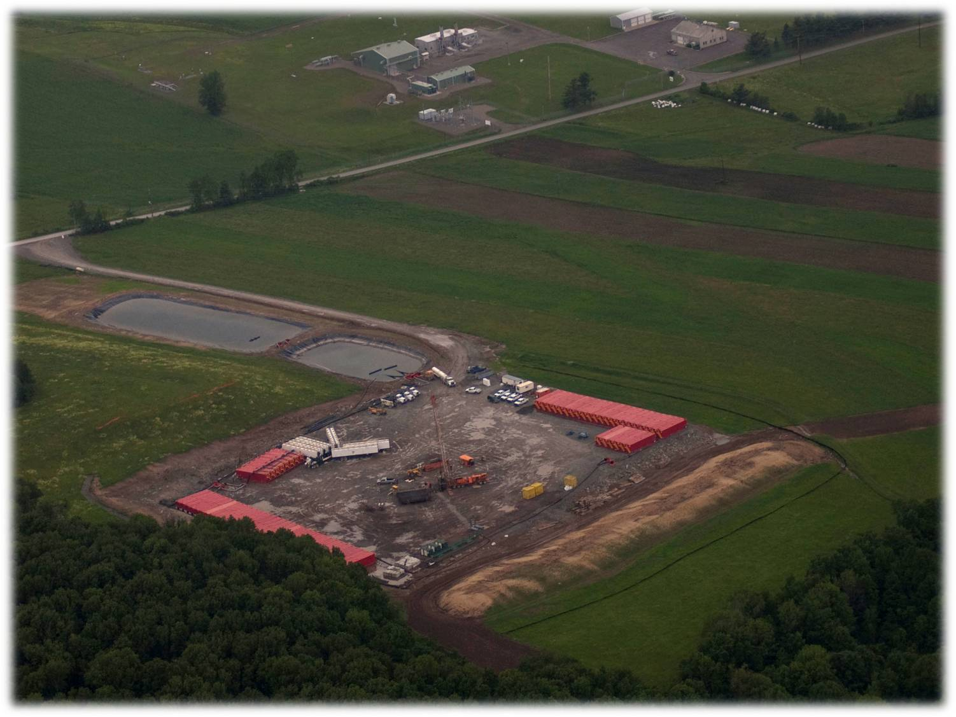

Slide 6
Past Experience with Energy Booms
An extensive research literature on energy boomtowns exists
Direct & significant influence on population, affecting nearly all sectors of the community – Housing, Culture, Public Services
Local governments are often unprepared by waves of growth
Economic impacts are mixed- some sectors benefit more than others
Source: NERCRD Paper No. 43
Notes:
Research literature based upon energy boomtowns in the west during the 1970s and 1980s

Slide 7
Pennsylvania’s Boom Town History
Timber
Coal
Strip Mines
Deep, long-wall mines
Oil and Gas
Steel
Glass
Limestone

Slide 8
Stages of Attitude in Boomtowns
Enthusiasm – see job & income possibilities. Dismiss possible negative impacts
2. Uncertainty – town starts to change, some negative impacts occur, divisions occur within the community
3. Concern – activity and impacts grow faster than anticipated, long term residents become confused or angry
4. Adaptation – core problems are identified, planning & mitigation strategies are developed.
Source: Gilmore (1976) in NERCRD Paper No. 43

Slide 9
1. Community Impacts
24/7
Sights and Sounds
Light
Police
Emergency Management Services
School Enrollment
Housing and apartment availability and prices

Slide 10
1. Community Impacts (continued)
Population increased
Employment
Unemployment declines
Increased opportunities for entrepreneurship
More jobs/Workforce pressure
Maintenance/Repair
Construction
Retail trade
Income
Median family and household income increased dramatically
Homes/Rental
Home values increased
Rental rates increased
Building permits increased
Traffic
All vehicle traffic up, especially truck traffic
Notes:
This is our experience in PA…..may be different elsewhere, but a basis for learning.

Slide 11
Pennsylvania and Land Impacts
Size - 119,283 km². (46,055 sq. mi.)
Population - 12,742,886 (2011 est.)
Estimated wells - 100,000 (conservative)
Well Pads - 18,000
6 wells per pad, 6 acres – 108,000 acres disturbed
After reclamation - 20,000 acres

Slide 12
Pennsylvania Experience: 47% of well pads on farmland

Slide 13
Pennsylvania Experience: 53% of well pads are on forest lands

Slide 14
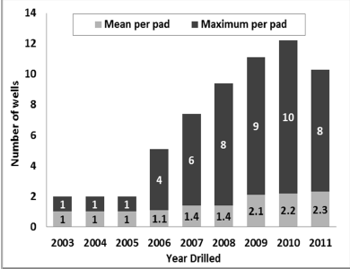
Multiple Wells per Pad

Slide 15
Community Impacts: Infrastructure Development
Pipeline-can’t truck it out
Development Gathering/ Midstream
Transmission
Compressors
Light
Noise
Air quality
Meter Stations
Utilization
Gas Processing
Water Quantity and Treatment
Trucking
Rail
Oil Field Service Companies
Lay-down yards
Pipe yards
Storage
Regulatory

Slide 16
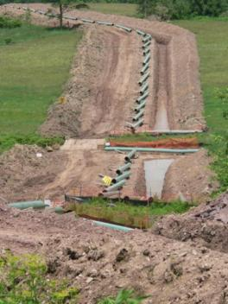
Transmission Pipeline and Reclamation
The Viewshed
Notes:
Photo of a restored pipeline ROW. The same site in progress in upper right.

Slide 17
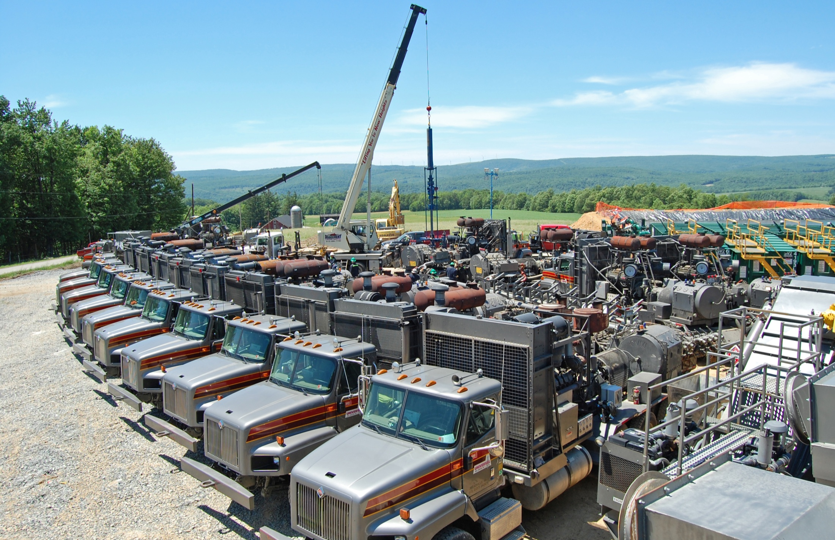
Noise & Emissions; 20,000 HP
Photo Courtesy
Universal Well Services

Slide 18
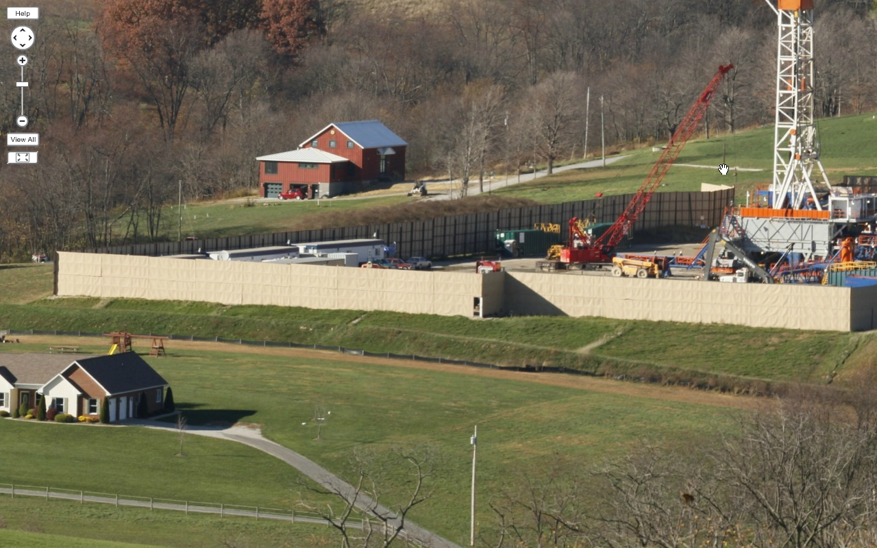
Noise Suppression Blankets

Slide 19
Bradford County, PA Traffic

Slide 20
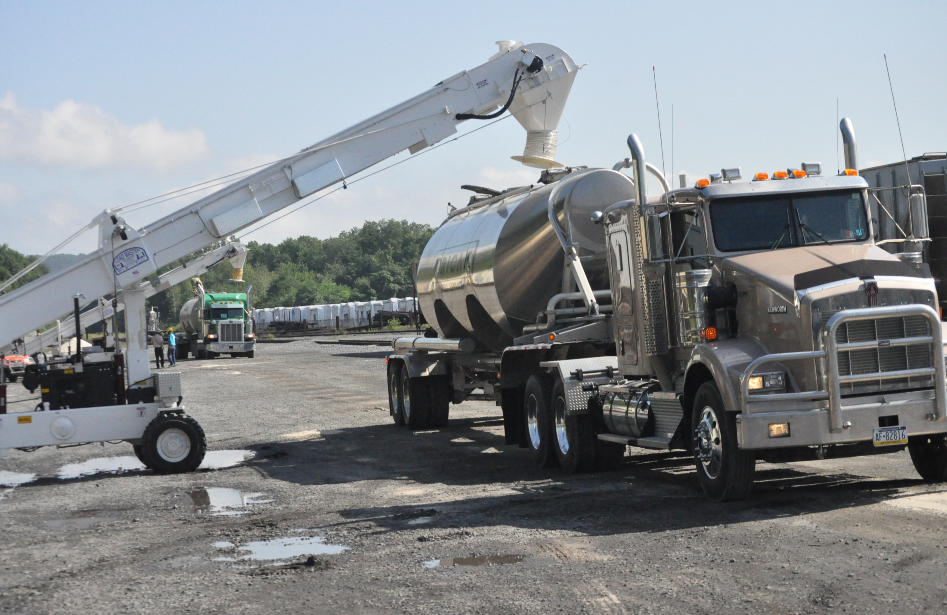
Support Industries and Land Use
Sand
10-12 truck loads sand per frac stage
23-25 railroad cars of sand/well
17,000’ of steel well casing/well
Courtesy: Tim Kelsey

Slide 21
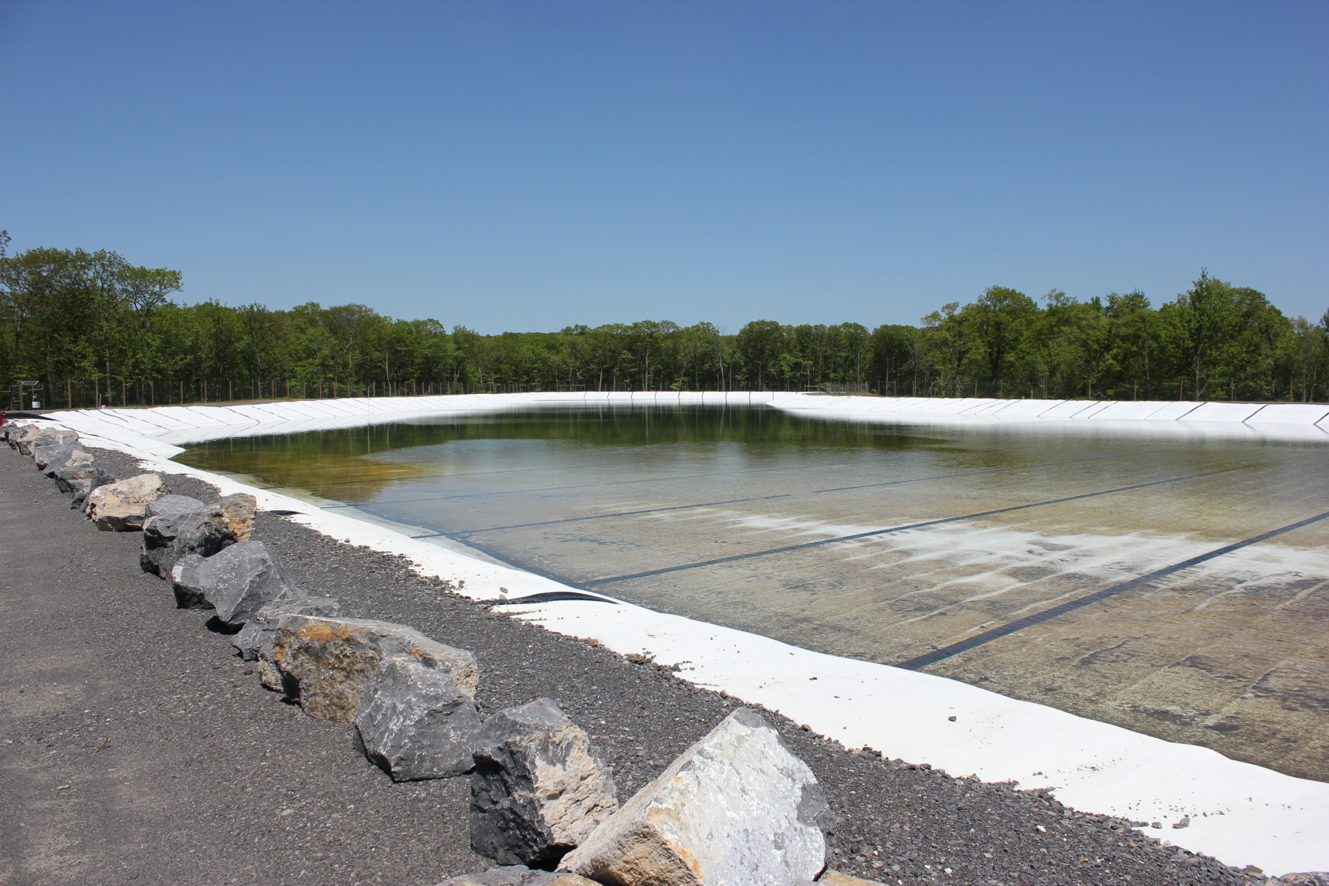
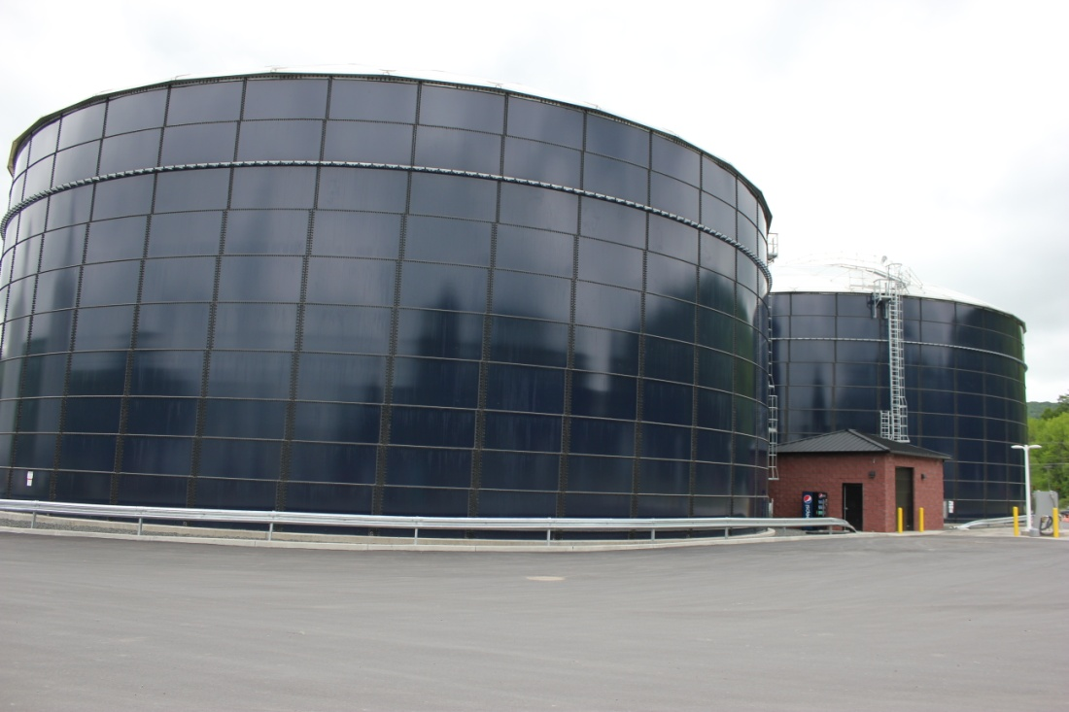
Support Industries and Land Use
900-1200 water trucks per well
Water is railed in, removing truck traffic. Pipelines in use.

Slide 22
1. Community Impacts
Most jobs will be “Blue Collar” (75%)
Workforce required to drill a single well will require 420 individuals working across 150 different occupations/jobs
Natural gas infrastructure (processing capacity, pipeline, storage) may impact job growth
Natural gas pricing will likely impact growth

Slide 23
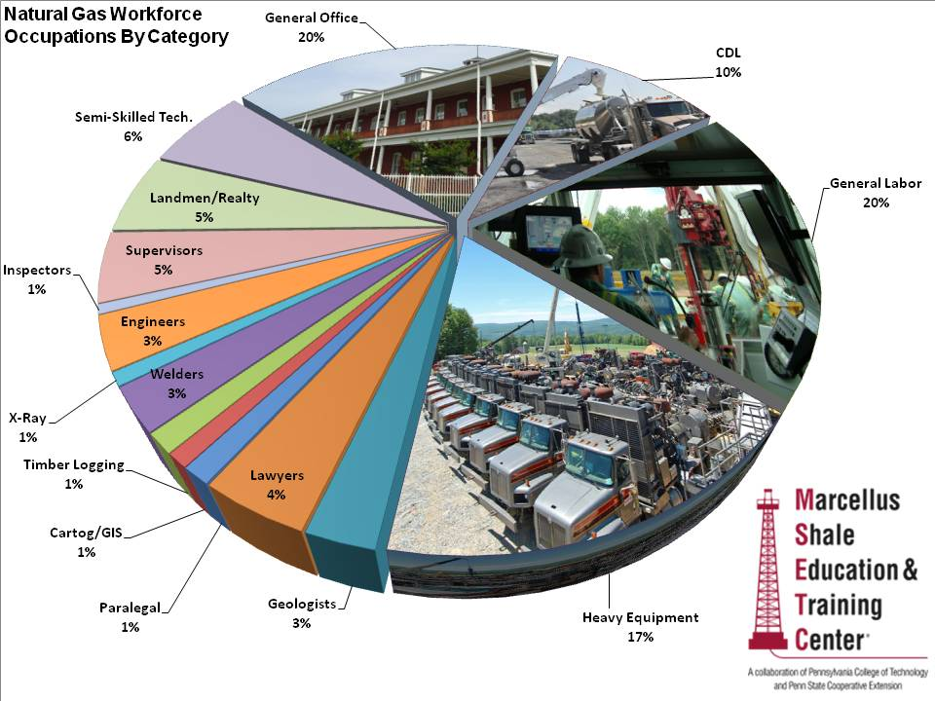
Source: PA Marcellus Shale Workforce Needs Assessment http://www.msetc.org/

Slide 24
Three Phases of Natural Gas Development
Development Phase (Short Lived/Labor Intensive)
Well-pad and Access Road Construction
Local collection pipeline Construction
Drilling of the Well
Fracturing of the Well
Reclaiming some Disturbance
Production Phase (Long lived/Small & Steady Labor Force)
Trucking Water and condensate from Well Site
Monitoring Production
Occasional Well Work-Overs (partially re-drill/re-frac)
Reclamation Phase
Dismantle and Reclaim well-sites
Source: Jacquet
Notes:
When thinking about the economic and employment impact of natural gas, its vital to keep in mind the varying labor needs throughout the phases of natural gas production.
There are three distinct phases, which very different labor requirements:

Slide 25
Workforce Through The Three Phases:
Notes:
This slide illustrates how employment needs vary, based upon the phases of development. During the drilling and pipeline building process, lots of jobs are created. But once all the wells are drilled, the ‘surge’ of employment passes. There are a steady number of jobs (typically well paying ones), but not at the same level as early.
This variation in employment needs creates planning questions/issues- how ensure enough housing for the ‘boom’ time, without over building so you have too many during the later stages?

Slide 26
Business Impacts – Hotel Taxes Collected

Slide 27
Business Impacts - Rail Car Traffic

Slide 28
2. Socialization Process Local Government and Their Role
Town Hall meetings
Community Task Force
Consultation
Dialog with regulators and industry
Residents
Perception
Transparent
Public meetings
Newsletters

Slide 29
Community and Local Government Issues
Roads & Bonding
Water
Population growth and change
Infrastructure
emergency preparedness
human service, education
Housing needs
Cultural change (conflicts?)
Economic development
Environmental impacts
Workforce development opportunities
Notes:
Not just Roads & Taxes!

Slide 30
2. Socialization Process Industries Role
Town hall meetings
Community picnics
Citizen committees
Community tours
Newsletters
Open communication with local leaders
Community involvement

Slide 31
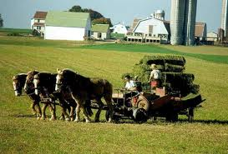
Another Perspective: Pennsylvania Amish
Migrated from Switzerland/Germany in the 1700’s
No electricity, vehicles,
telephones, tractors
Generally Farmers/Landowners
Dairy
Direct marketers of food products
Furniture
Sawmills
Conservative
Desire for farm to continue with sons

Slide 32
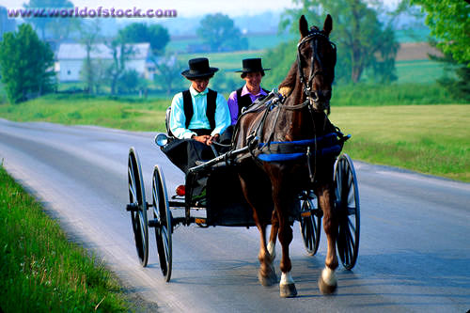
Amish Community Decision-Making
Community members have some input
Local board of Amish community elders
Local Bishop has ultimate decision
Every Amish community may
look at an issue
differently.

Slide 33
Pennsylvania Amish
Shallow gas production exists on their farms
Concerns are similar to other residents:
Environmental questions?
Effect on their lifestyle and community?
Opportunity for the farm business to continue?
Limited employment opportunities
Seek information
Generally accepting of the industry

Slide 34
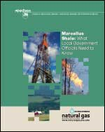
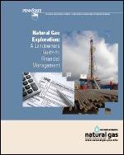
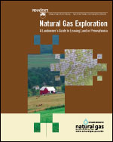
Web Resources
www.naturalgas.psu.edu
www.marcellus.psu.edu
www.msetc.org
PA DEP Bureau of Oil and
Gas Management
© Penn State Extension, 2011

Slide 35
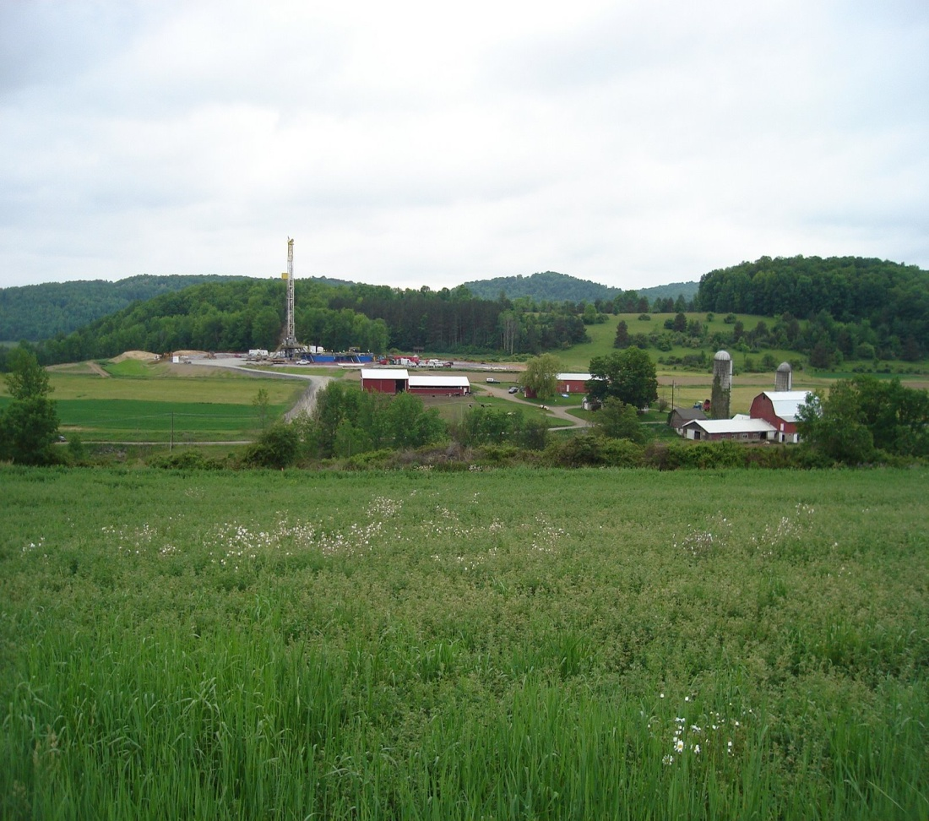
Thank you.
Jon Laughner
JBLaughner@psu.edu
Penn State Marcellus Center & Marcellus Shale Education and Training Center

Slide 37
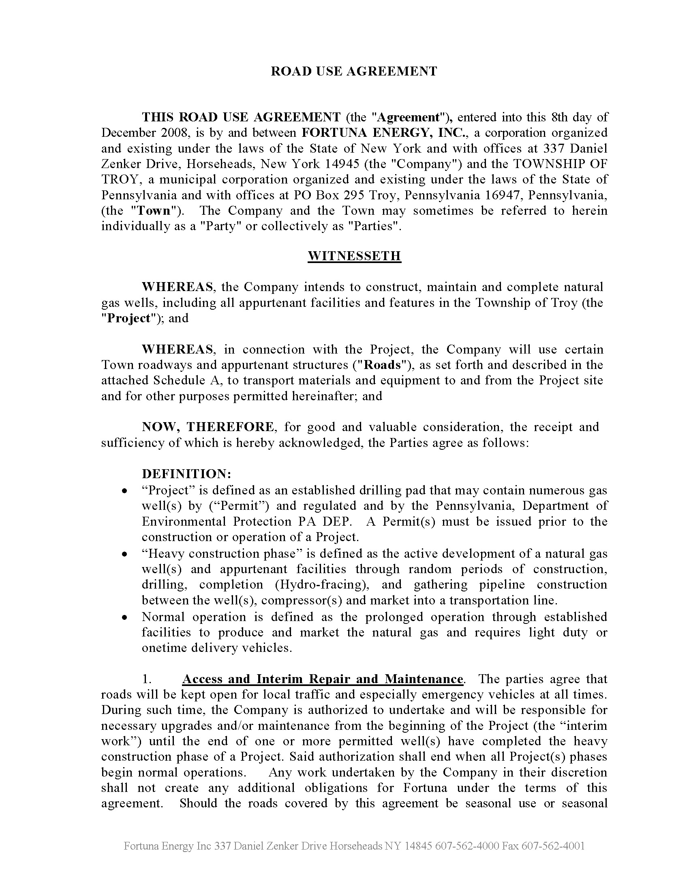
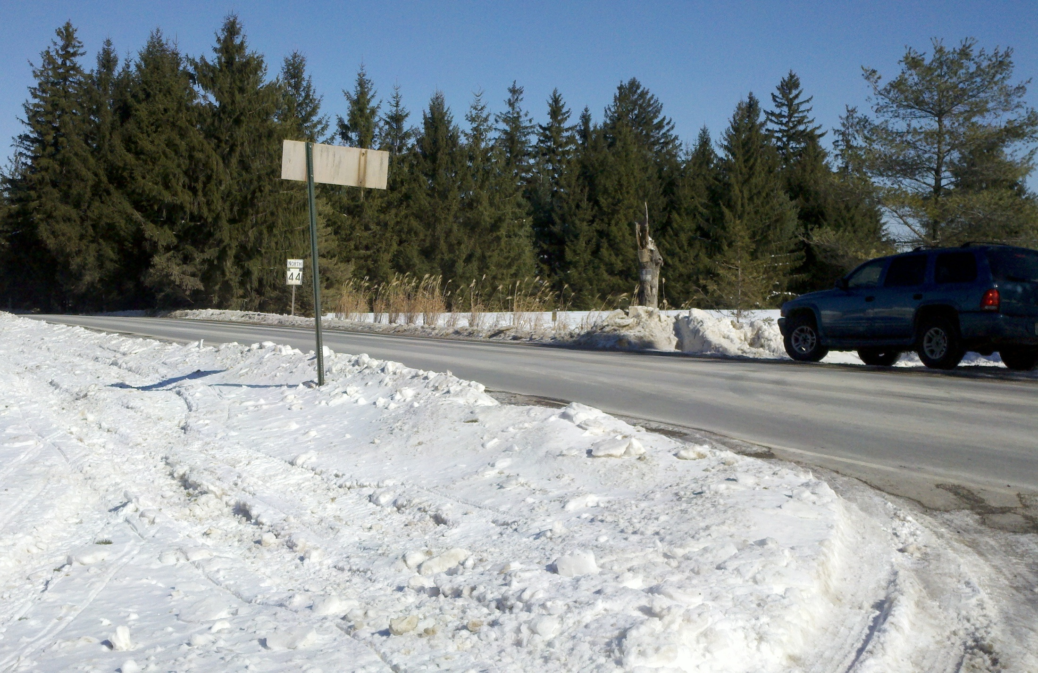
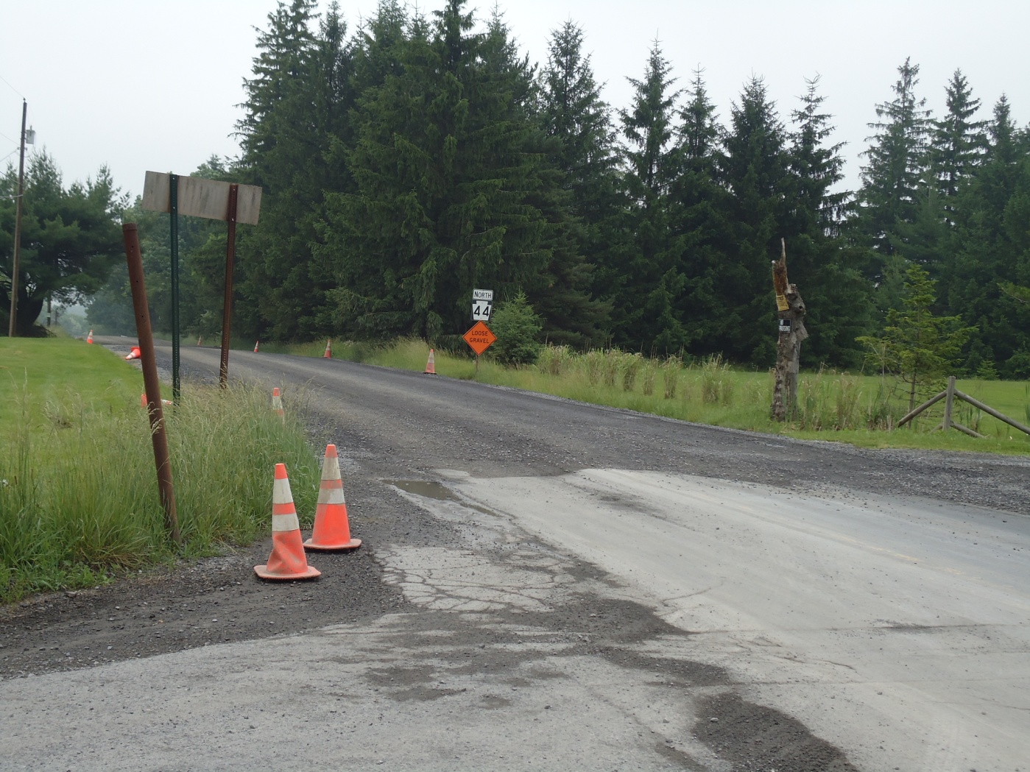
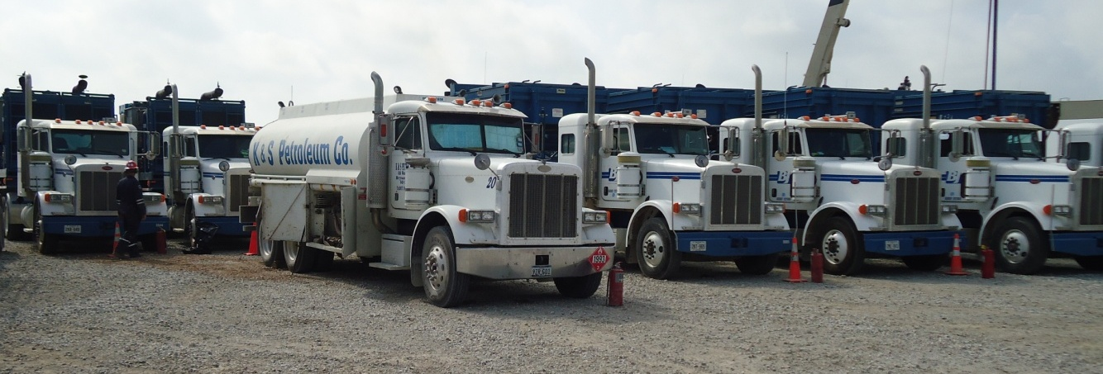
Road Use Agreements
Notes:
Up through 2012, natural gas co. have spent ~$500 million to repair PA roads.

Slide 38
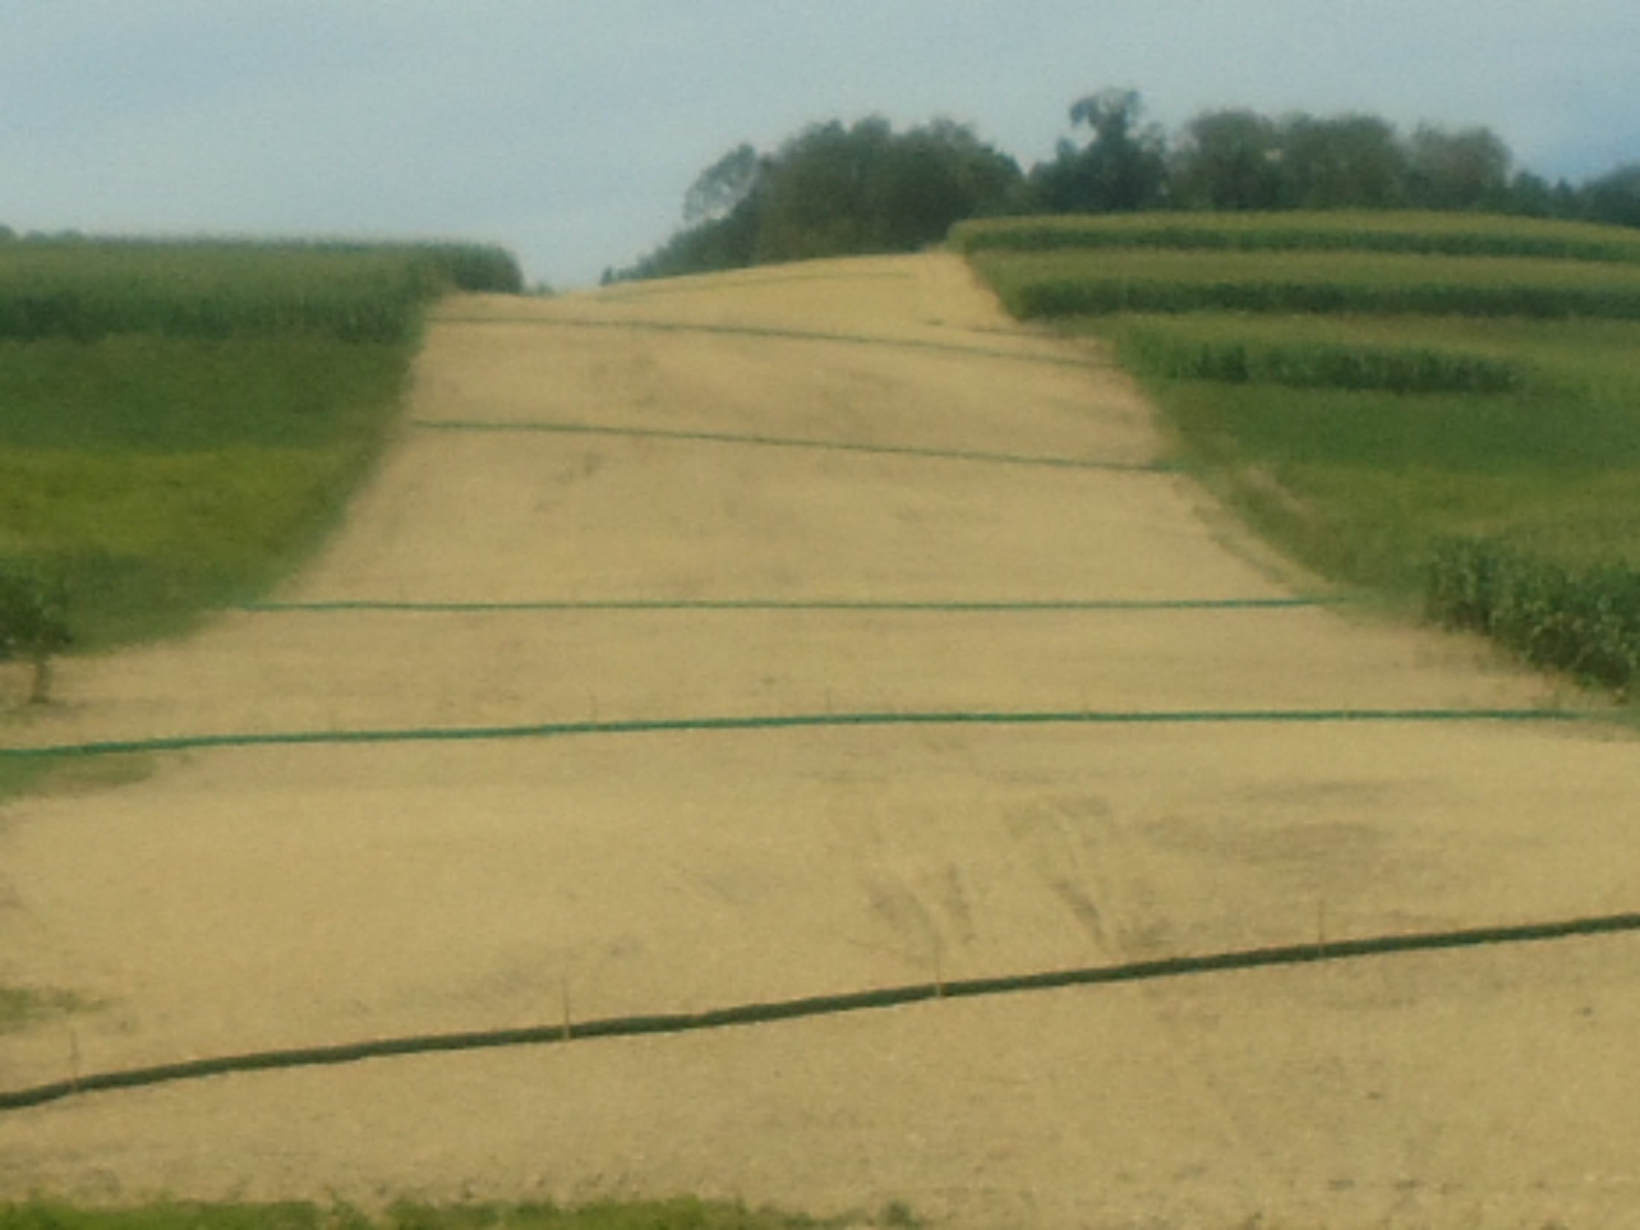
Reclaimed Pipeline Right-of-Way

Slide 39
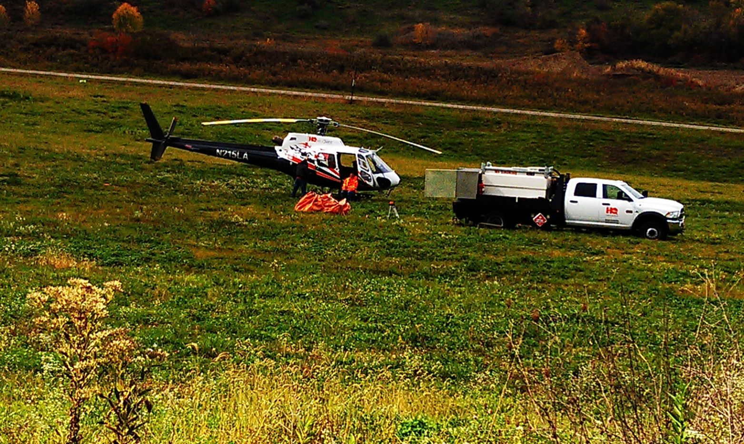
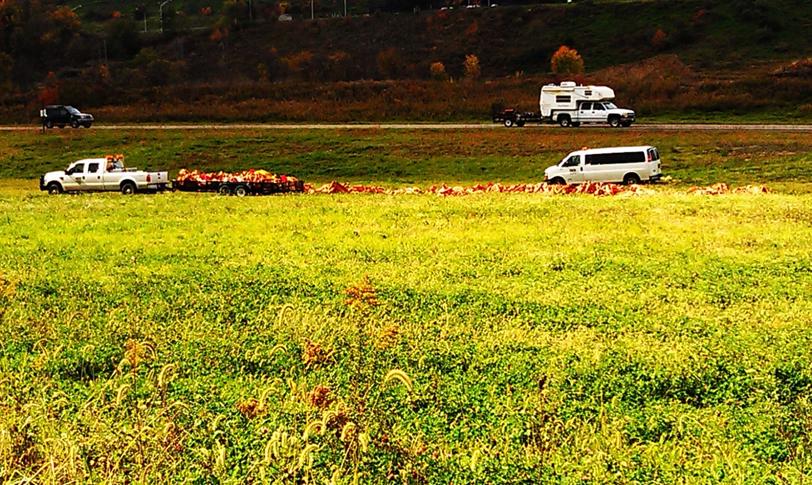
Support Industries

Slide 40
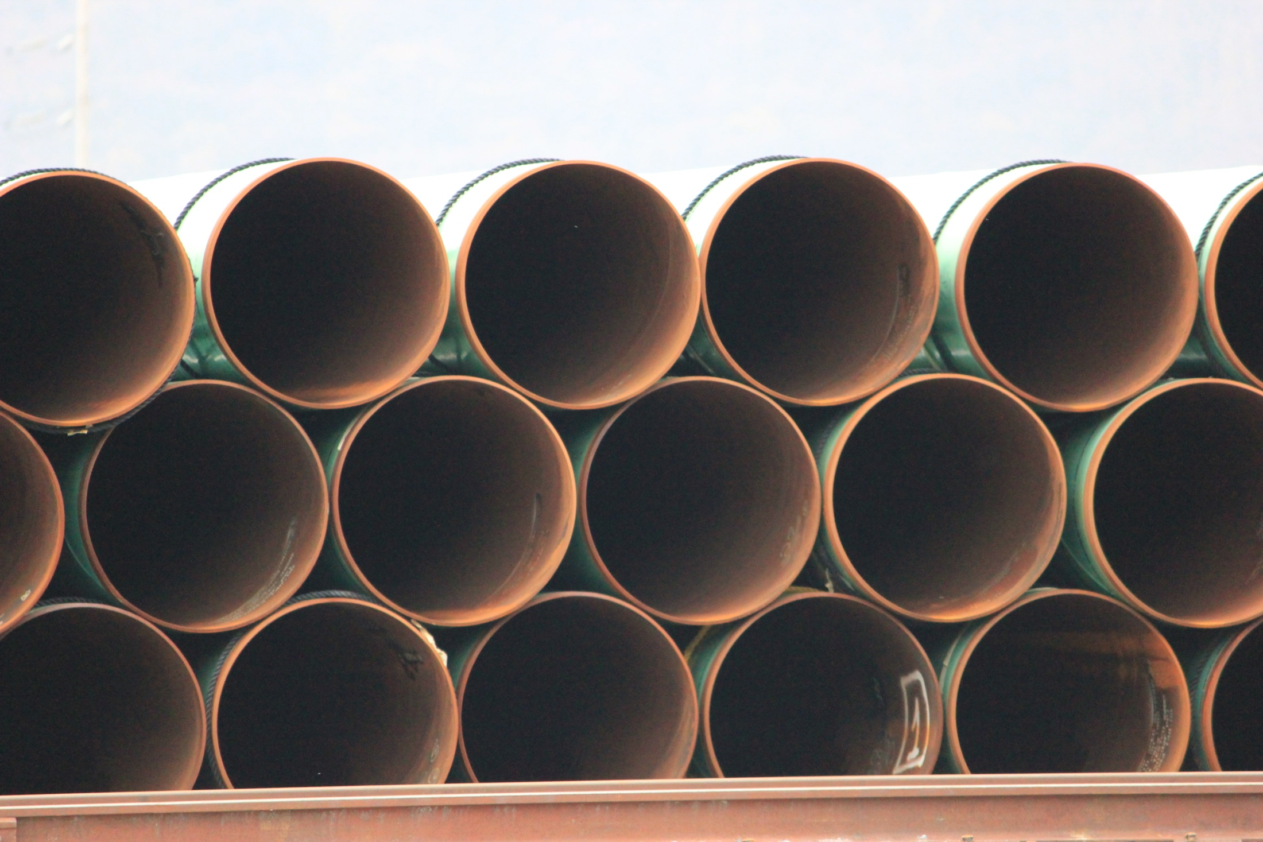
Natural Gas Pipeline
Gathering
Transmission
Distribution

Slide 41
Reclamation Status for 1283 pads
84% - no reclamation
16% - reclaimed
Well Pads
Local disturbance went
from 6.7 acres to 1 acre
after reclamation
Most reclamation was
to a grassy cover crop

Slide 42
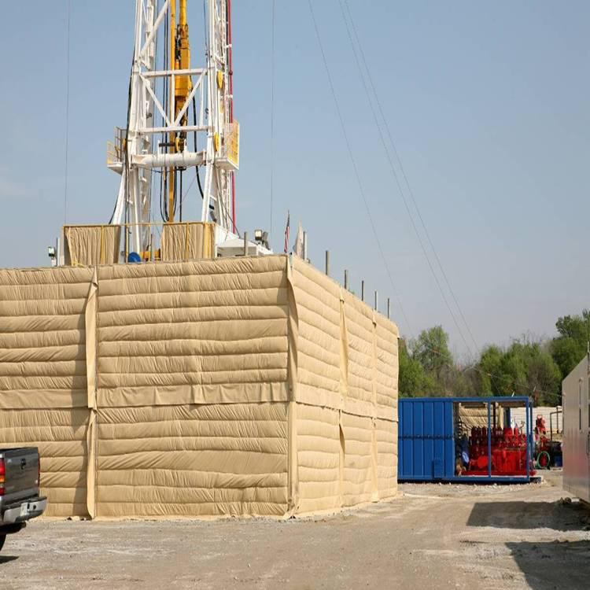
Noise Suppression Blankets

Slide 43
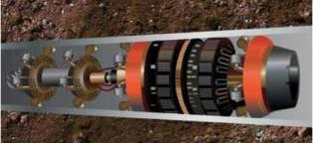
Pipeline Maintenance

Slide 44
Larger Well Sites Needed for Bigger ‘Fracs’

Slide 45
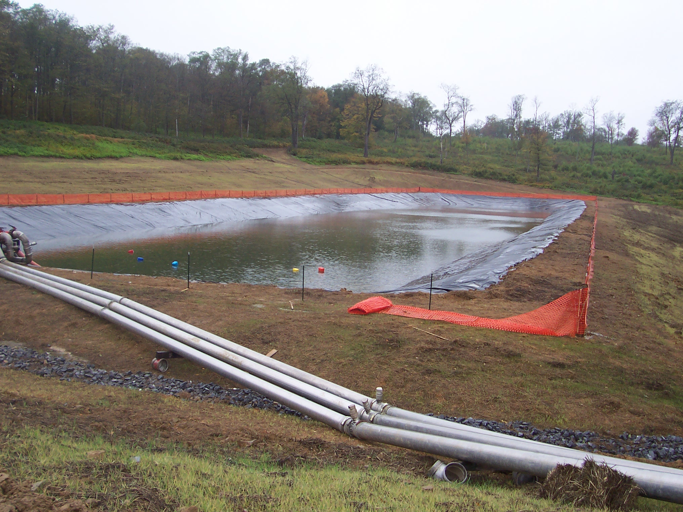
Frac Water Impoundment
Notes:
McKean County 9-29-09 Jim Clark

Slide 46
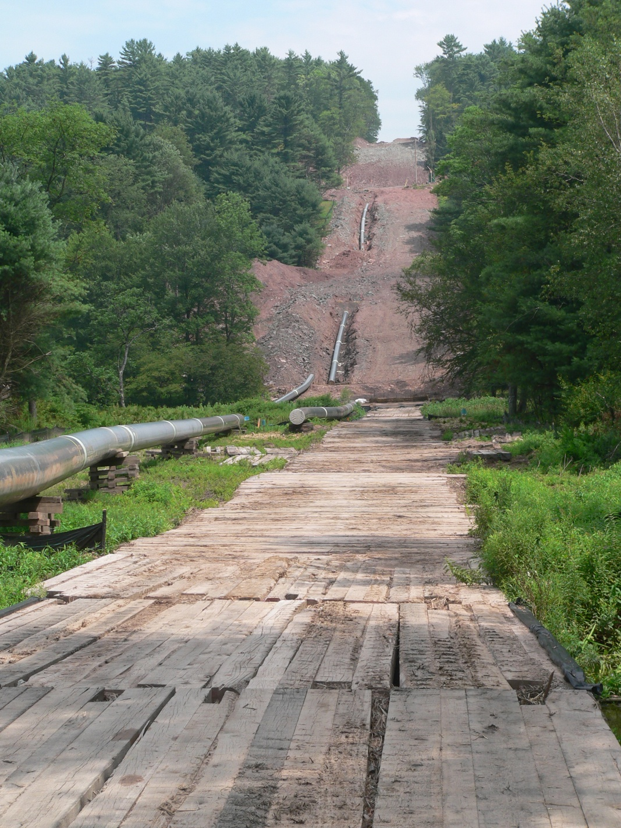
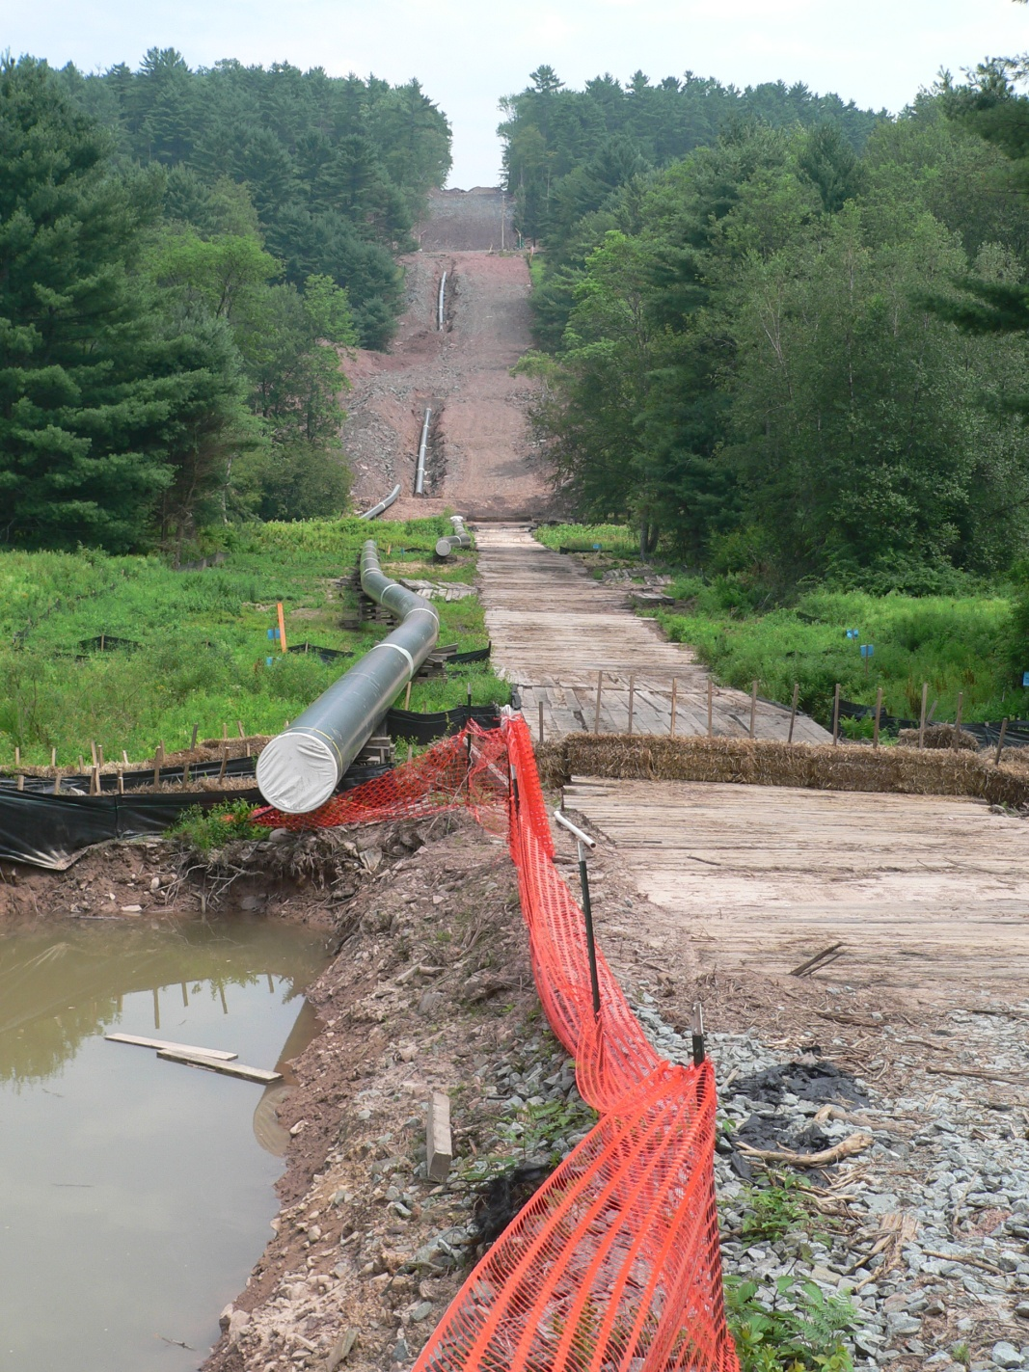
Transmission Pipeline
The Viewshed
Photo Courtesy Dave Messersmith
Photo Courtesy Dave Messersmith
Notes:
Concerns, will this change in view affect tourism?

Slide 47
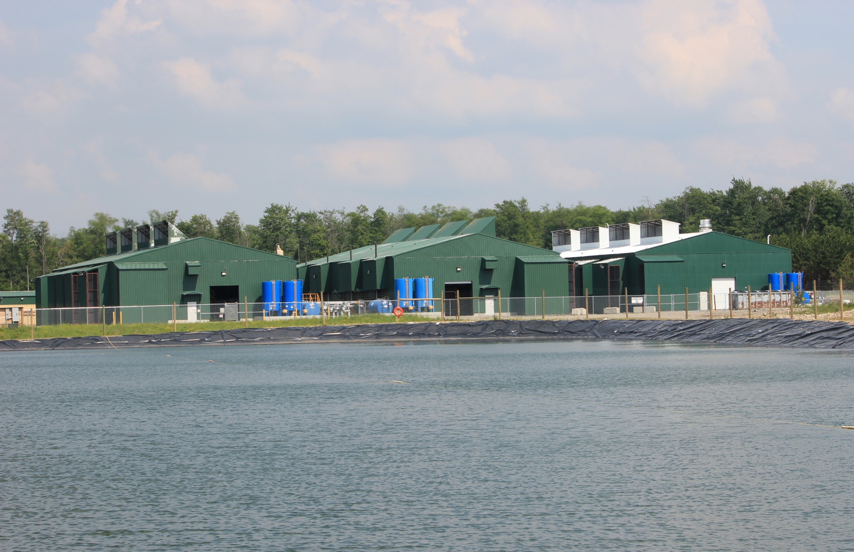
Production

Slide 48
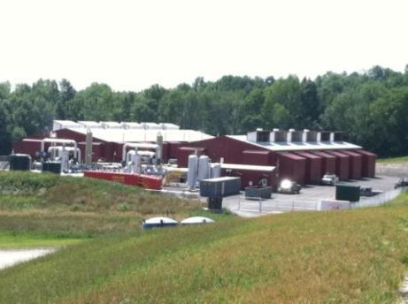
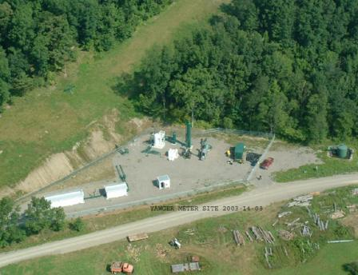
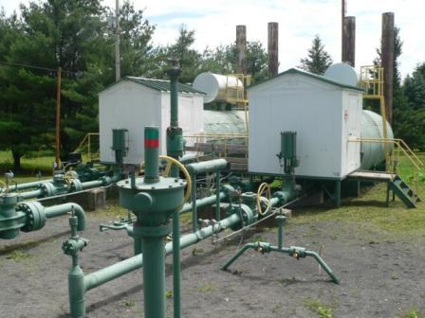
Notes:
Open and enclosed compressors on left. Drying and metering stations on right (bottom right is an older drying station at the Leidy Storage field in Clinton county). Landowners can (should) eliminate these structures from a ROW agreement and negotiate them in a separate contract.
Ask the audience to think about how these structures can be fenced, landscaped, enclosed, painted in earth tones, etc to reduce their visual impact? What about sound mitigation? Are there air quality concerns with these facilities? What are they?

Slide 49
Could transform communities – but for the better or worse?
Requires careful decision-making about:
Thinking long term, not just short term gain
Monitoring, understanding & mitigating environmental impacts
How can this be used to improve our community in long run? Other industries this could attract?
Encouraging dollars to stay local
Workforce training
Business development
Housing

Slide 50
Could transform communities – but for the better or worse?
Manage the ‘Boom’ without having a ‘Bust’?
“Short term” housing & worker needs?
Plan NOW for when the gas no longer flows
Need for monitoring, adapting regulations and recommended practices
Social and cultural change
Revenue sharing
Environmental remediation and use of conservation practices
Notes:
Boom vs Bust – manage short term

Slide 51
Could transform communities – but for the better or worse?
Balancing private gain and public good
Local control & voice?
Quality of life impacts?
Effects on other businesses?
Who pays for public service impacts (and how)?

Slide 52
Effective Responses Will Require…
1. Coordination and communication - among partners, jurisdictions, agencies, organizations, related and ancillary businesses
2. Broad public awareness and understanding
3. Resident and taxpayer acceptance and support
4. On-going dialogue and participatory decision-making
Notes:
One of the ways that communities and groups are responding is to communicate, cooperate, and work collectively and proactively across the community – rather than it being done piecemeal and without any coordination.
Some communities have created local task forces that bring together the varied and diverse groups potentially being affected by gas development, so they can work together- local government officials, business community, landowners, human service providers, local schools, workforce training providers, and others.

Slide 54
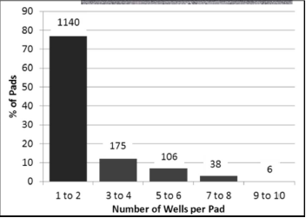

Slide 55
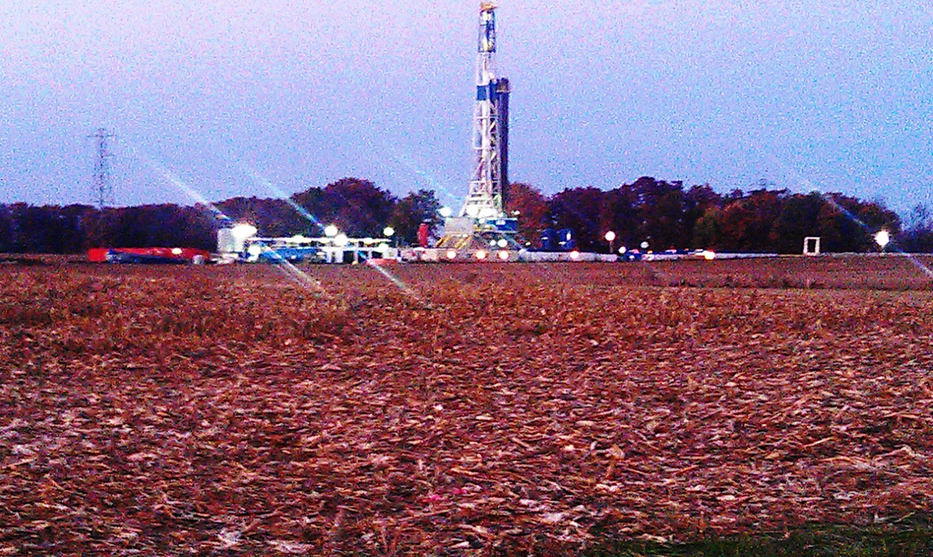
Light

Slide 56
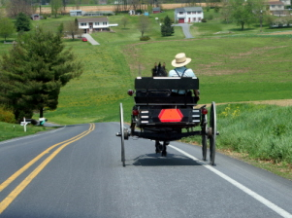
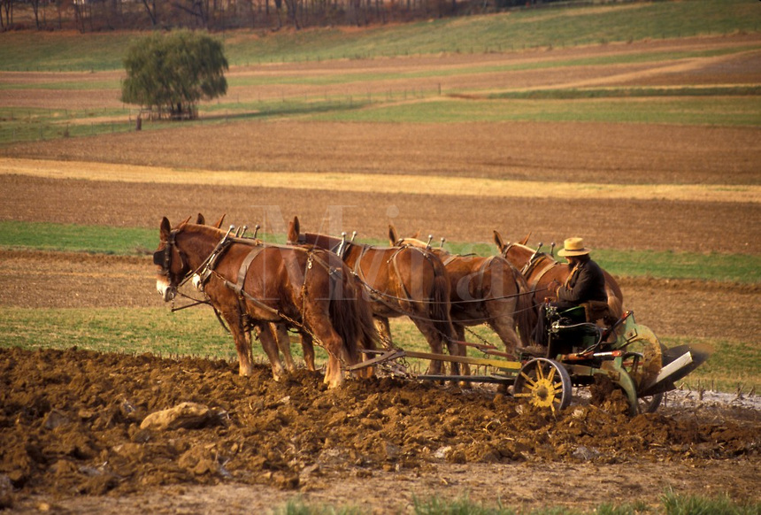
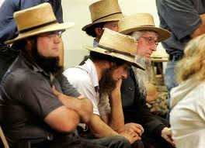
Pennsylvania Amish

